Slide 1
2022 DER RFP
Bidders’ Conference
Feb 28, 2022

Slide 2
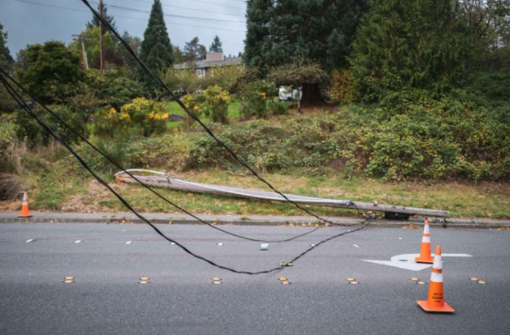
Safety Moment – Staying Safe Around Downed Power Lines
STAY AWAY! – At least 35 feet if possible
Don’t touch anything touching the power line
Call 911 to report the downed power line
Shuffle away if you are closer than 35 ft.
If you are safe in a car – stay in the car
If you are in a car, but not safe – jump clear, land with both feet, shuffle away

Slide 3
How to use Zoom
Attendees will remain in listen-only mode
The “chat” feature is disabled
Enter questions anytime in the Q&A box – organizers will read questions and answers aloud during Q&A periods, but feel free to submit questions at any time. A complete list of conference questions and answers will be posted on the RFP website within a few days after the event.
Call-in participants can still access the Q&A box if viewing the presentation online
If you have a question,
type it in the Q&A box!

Slide 4
Introductions
Puget Sound Energy
Guidehouse
DER RFP Consultant
Stuart Schare
Debyani Ghosh
Katie Bertcher
Kimo Spector (Com. Acq. Lead)
Anne Marshall (Strat. Dev. Lead)
Jessica Raker (DER Mgr.)
Brian Tyson (CEIP Mgr.)
Jeff Tripp (Strat. Prgm. Mgr.)
Connor Birkeland (Snr. Analyst)

Slide 5
Meeting Objectives
Communicate the drivers and goals of PSE’s DER RFP
Review resource needs and requested vendor services
Review the evaluation process
Demonstrate the bid preparation process
Address questions from prospective bidders

Slide 6
Agenda
DER RFP Overview
Category A: Turnkey Resource Acquisition
Category B: Vendor Service Components
Q&A (15 mins)
Break (10 mins)
Evaluation Process
Schedule and Proposal Requirements
Bid Preparation
Resources for Bidders
Q&A

Slide 7
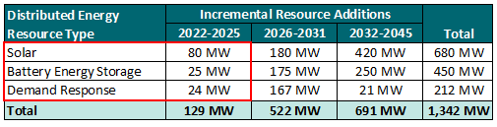
DER RFP Overview
1
DER RFP Overview
Resource need: minimum of 129 MW by 2025 and 522 MW by 2031; includes the following
  Distributed solar
  Battery Energy Storage (BESS)
  Demand Response (DR)
PSE’s priorities for the DER RFP
  Add DERs to meet system needs and fulfill Clean Energy Transformation Act (CETA) compliance requirements
  Maximize customer benefits
DER RFP will be aligned with the 2021 All-Source RFP

Slide 8
Acquisition Categories
1
DER RFP Overview
Category A: Turnkey Resource Acquisition
Applies to DR, BESS resources and solar PSE requests bids for: Turnkey pay-for-performance, ownership contracts or power purchase agreements for delivering DR, BESS, or solar.
Category B: Vendor Service Components
Applies to future PSE DER Programs, including DR, BESS and solar programs PSE requests bids for: Program services where Respondents could select one or more service components to bid on Category B proposals will be built into Value Fit programs
Respondents can submit proposals under either Category A or Category B or can submit bids under both categories A and B. Multiple proposals under each or both categories are acceptable, but each proposal requires a separate response.
Acquisition categories will be discussed in greater detail throughout the conference.

Slide 9
CEIP Preferred Portfolio
1
DER RFP Overview
Solar
Multi-Family roof-top solar incentive
C&I roof-top solar incentive
3rd party distributed solar PPA
Residential roof-top solar leasing
Batteries
C&I space leasing for batteries
Residential PSE Battery Leasing
Customer-sited solar + storage
Demand Response
Residential or SMB DLC Water Heater and Space Heat
C&I DR
Community solar
PSE identified a selection of DER programs to meet the 2021 IRP DER targets
This preferred portfolio should be used as a guide to the type and mix of programs that PSE is interested in
PSE expects this RFP to result in the acquisition of programs that provide the same benefits as in the preferred portfolio, but does NOT expect bidders to exactly match the preferred portfolio

Slide 10
CEIP and Customer Benefit Indicators
1
DER RFP Overview
Customer benefit indicator (CBI) is an attribute, either quantitative or qualitative, of resources or related distribution investments associated with customer benefits described in RCW 19.405.040(8).
Customer benefit indicators are outcomes that improve customers lives
Customer benefit indicators will:
  Shape programs, actions and investment decisions
  Help ensure all customers benefit from clean electricity transition
  Be used through energy resource planning process (e.g., CEIP, Integrated Resource Plan, Clean Energy Action Plan)

Slide 11
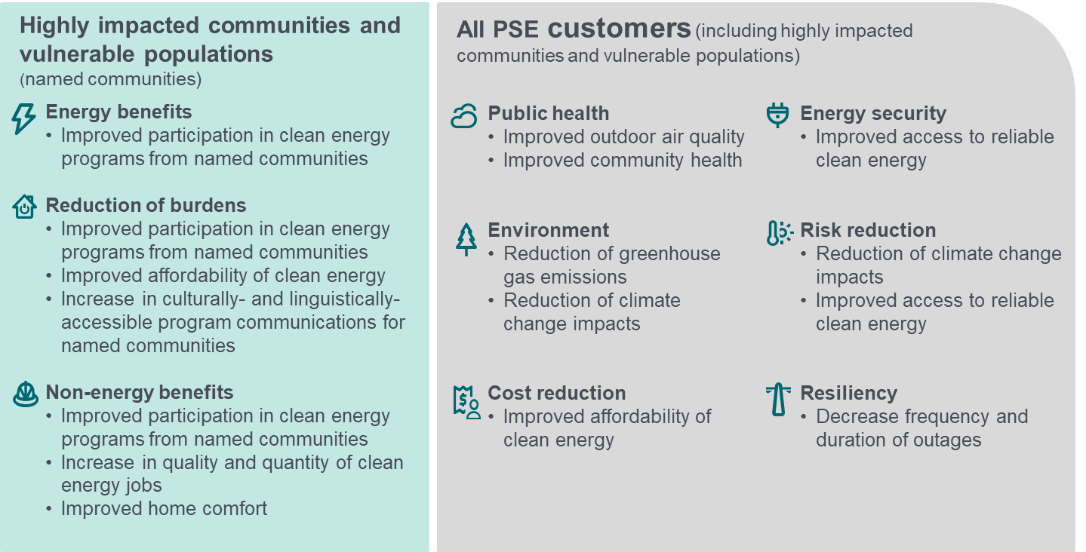
CBIs for Qualitative evaluation
1
DER RFP Overview
Below are the CBIs used in the qualitative evaluation of the RFP
The DER RFP is a targeted resource acquisition focused on direct customer and local community programs, which differs from the All-Source RFP that seeks utility scale resources. The DER RFP has a greater impact on targeted CBIs because of this, especially CBIs focused on named communities. To appropriately capture DER impacts, CBIs have been directly included in the qualitative evaluation.

Slide 12
Category A: Turnkey Resource Acquisition - Overview
2
Category A
Resources Types
Expected Bid Structure
Solar
Demand Response (DR)
Turnkey pay-for-performance for DR and BESS
Ownership contracts for solar and BESS
Power Purchase Agreements (PPA) for solar
Purpose of Category A bids
Aggregated and individual solar and other DER resources that are accessible across multiple customer types.
Battery Energy Storage Systems (BESS)
Turnkey resources that maximize grid and customer benefits.
Adapted from: PSE DER RFP Table 1

Slide 13
Turnkey Resource Acquisition – Resource Types
2
Category A
Each resource type corresponds to one tab (3a, 3b, or 3c) in Exhibit B. Bidders must respond to the requirements listed for resource type they are bidding.
Solar
Battery Energy Storage System (BESS)
Demand Response (DR)
PPA/Ownership
Pay-for-performance contract/Ownership
Pay-for-performance contract
Includes Front-Of-The-Meter (FTM) and Behind-the-Meter (BTM) solar
FTM projects must interconnect to PSE’s distribution system
Minimum 80 MW cumulative needed by 2025
Includes FTM and BTM BESS
BESS could be either standalone or paired with solar for both BTM and FTM systems.
FTM projects must interconnect to the distribution system
Minimum 25 MW cumulative needed by 2025
Includes any type of curtailable BTM load at customer sites that could be dispatched (load shed and/or load shift) during DR events in response to grid needs
Includes distribution and transmission interconnected customers
Minimum 24 MW cumulative needed by 2025
Adapted from: PSE DER RFP Table 4

Slide 14
Turnkey Resource Acquisition – Proposal Requirements
2
Category A
Category A bidders must submit:
  Exhibit B: Proposal Requirements
  Exhibit D: Mutual Confidentiality Agreement
  Exhibit I: Master Services Agreement
  Term sheets as applicable
    Exhibit F: Prototype Ownership Agreement Term Sheet
    Exhibit G: Prototype Capacity and/or Energy Agreement Term Sheet
    Exhibit H: Prototype Clean Energy PPA Term Sheet
  Exhibit P: PSE Customer Consent Letter (as applicable)
Other exhibits are for reference or for Category B, see table 12 in the RFP

Slide 15
Category B: Vendor Service Components - Overview
3
Category B
Vendor Service Components
Expected Bid Structure
Services for future PSE DER Programs, including solar, DR, and BESS programs:
PSE will use the bids to develop a portfolio of programs
Purpose of Category B bids
Apply diversity, equity and inclusion (“DEI”) best practices by providing opportunities for small, diverse businesses to participate in the procurement process and maximize impact to the local economy.
Program Design
Customer Outreach and Enrollment
Equipment Installation
Equipment O&M
Program Administration
Other
Leverage community organizations to maximize benefits to named communities.
Program services (listed above) where Respondents could select one or more service components
Adapted from: PSE DER RFP Table 1

Slide 16
Vendor Service Components – Component Categories
3
Category B
Program Design
New offerings designed to help customers reduce peak grid loads, increase customer participation in clean energy programs, and maximize customer benefits from DERs in every stage
Customer Outreach and Enrollment
Tasks related to recruiting customers - including marketing, advertising, and executing Participant Services Agreements
Equipment Installation
Procurement and installation services for one or more programs/customer segments
Equipment O&M
O&M services for one or more programs/customer segments
Program Administration
Collaborate with PSE program team to achieve specific DER program targets (budgets & capacity/energy), forecasting, strategic planning, and customer issue resolution
Other
Bidders may propose a separate ‘other’ component if the services being proposed do not fit the above-mentioned

Slide 17
Vendor Service Components – Proposal Requirements
3
Category B
Category B bidders must submit:
  Exhibit C: Proposal Requirements
  Exhibit D: Mutual Confidentiality Agreement
  Exhibit I: Master Services Agreement
  Exhibit N: IT Security Questionnaire
  Exhibit P: PSE Customer Consent Letter (as applicable)
Other exhibits are for reference or for Category A, see table 12 in the RFP.
Category B bidders to provide indicative pricing as part of Exhibit C. Bidders may be requested to provide additional information as needed during the evaluation phases.

Slide 18
Q&A

Slide 19
10 Minute Break

Slide 20
Evaluation Process
4
RFP Process
PSE has designed this evaluation process to select highest-value offers, including customer benefits, supplier diversity and cost from Category A (Turnkey Resources) and Category B (Vendor Service Components)
This process mirrors the All-Source evaluation process, and concludes with a concurrent evaluation with the All-Source short-list
Phase 1
Category A and Category B bids evaluated separately – Individual scores developed
(BCA Model, Indicative Pricing and Qualitative Evaluation)
Phase 2
Category A bids and Value Fit Programs (Including Category B bids) evaluated and short list selected
(BCA Model)
Concurrent Evaluation
Short list DER programs and resources assessed with entire PSE Portfolio, including 2021 All-Source RFP short list
(Aurora)
Source: PSE DER RFP Figure 7

Slide 21
Phase 1 Qualitative Evaluation
4
RFP Process
Qualitative evaluation (40%): risks, benefits, viability, CETA CBI contributions, equity
  Category A (Turnkey Resources) and Category B (Vendor Service Components) have their own respective rubrics due to the different requirements of each proposal. Both categories will be evaluated separately in Phase 1.
Rubric designed to evaluate key areas applicable to all projects regardless of technology type.
Phase 1 rubric evaluation will occur on all conforming proposals:
  Detailed information submitted by bidders Category A: Exhibit B and Category B: Exhibit C
  Bidders required to submit a CETA Equity Plan
  A “0” score on the rubric represents failure to meet RFP minimum criteria for certain categories
Category A (Turnkey Resources)
Evaluation Categories | Measures | Weight
1. Counterparty Viability | Experience with similar projects Counterparty stability | 10%
2. Project Viability | Financing plan Execution Plan Technology Risk | 10%
3. Site Control / Customer Acquisition | Land agreements status Customer acquisition plan | 20%
4. Permitting and Studies | Status of permitting and habitat studies | 5%
5. Energy Delivery | Interconnection on Distribution SaaS or on premise software Interface with VPP | 10%
6. CETA Equity Plan: Customer Benefits | Plan to address all CBIs | 25%
7. CETA Equity Plan: Business Values | ESG Policy SMWBE contracting Labor standards | 10%
8. Named Communities Enrollment | Commitment for named communities enrollment | 10%
Category B (Vendor Service Components)
Evaluation Categories | Measures | Weight
1. Counterparty Viability | Experience with similar projects Counterparty stability | 15%
2. Project Viability | Execution Plan | 15%
3. Site Control / Customer Acquisition | Customer acquisition plan (DR, DER) | 15%
4. CETA Equity Plan: Customer Benefits | Plan to address all CBIs | 35%
5. CETA Equity Plan: Business Values | ESG Policy SMWBE Labor standards | 20%

Slide 22
Phase 1 Quantitative Evaluation
4
RFP Process
Quantitative evaluation (60%): BCA analysis and indicative pricing
Category A proposals will be evaluated among similar resources using the Benefit Cost Analysis (BCA) model
Category B proposals will be evaluated among similar components (enrollment, installation, etc…) with indicative pricing. The project with the highest portfolio benefit/offer nameplate will receive the full score
At the end of Phase 1, PSE will select a pool of resources (the “Candidate List”) that represents best-performing proposals from different resource types. PSE will aim to advance as many proposals as needed such that resources in the candidate list amounts to at least 150% of the resource need.
Proposals that have been selected for the Candidate list will be given an opportunity to submit an updated best and final offer price
Category B (Vendor Service Components) Sample Pricing
Component | Indicative Pricing
Customer Outreach and Enrollment | Specify customer classes/segments and the types of DERs for which the Respondent is providing the pricing for Customer Outreach and Enrollment services. Provide unit pricing (e.g., $/1000 enrolled customers) for a hypothetical case (e.g., Solar PV installation for Res SF homes) and state the pricing assumptions for the types of DERs and customer segments being targeted. Clearly describe the unit for the proposed pricing Indicate how pricing varies by customer segments being targeted and by the type of DER. State the program scale (in terms of no. of customers and/or units being targeted) for which the indicated pricing applies and describe to how the pricing would change at a different scale of the program.
Equipment Procurement/ Installation | Provide the price for one installed system (unit price) and describe the configuration of the installed system by DER type and customer segment (e.g., a rooftop solar PV system with 4 kW peak output, installed at single family homes). Indicate underlying assumptions on the scale (no. of units proposed to be installed) for different types of DERs (Solar, BESS, DR) and applicable customer segments. Indicate price per unit for equipment installation. Equipment cost Installation costs with required labor hours for equipment installation Include any additional cost items related to equipment procurement and installation Indicate variations in unit price by customer segment, if applicable.

Slide 23
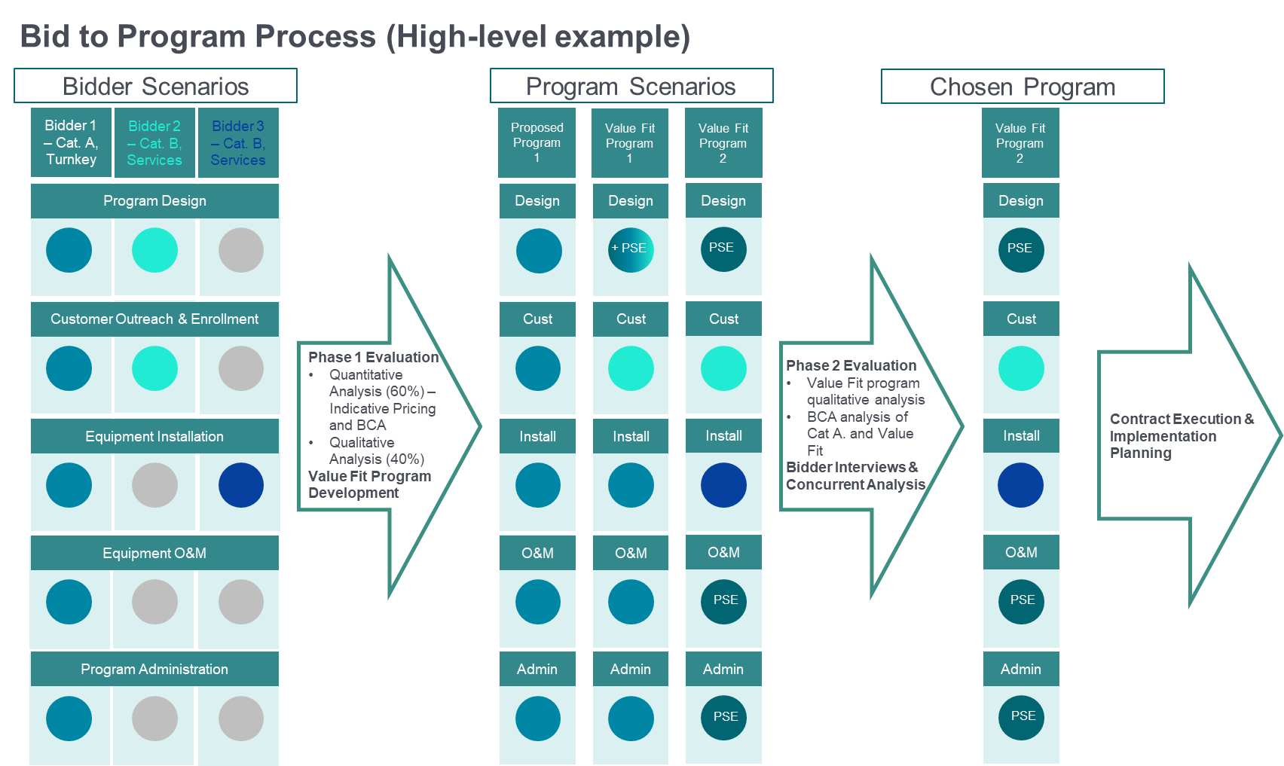
Phase 2 Evaluation
4
RFP Process
To equitably compare bids for turnkey resources with vendor services, PSE will work with bidders to construct Value Fit programs after the Phase 1 evaluation
These Value Fit programs may combine PSE capabilities and one or more Category B bids
Additional due diligence in Phase 2 will include:
  Term sheet review, where PSE will assess if proposals contain unacceptable terms or conditions
  Interviews to assess proposal and team capabilities
  Assessment of proposal capabilities in lieu of Exhibit K requirements
Source: PSE DER RFP Figure 6

Slide 24
Concurrent Evaluation and Negotiations
4
RFP Process
The shortlisted proposals from both the All-Source and DER RFPs will be assessed in the Concurrent Evaluation.
DER RFP proposals will not be removed during the Concurrent Evaluation and will instead be used to inform the All-Source chosen bids.
Negotiations will occur after the final shortlist is released. Depending on the resource or service provided, contracts will be executed as Power Purchase Agreements, Master Services Agreements with Statement of Work Agreements, or Sales and Purchase Agreements.
Metrics calculated by Aurora to assess RFP proposals
Metric | Description
Portfolio benefit ($) | Difference between the net present value portfolio revenue requirement with the proposed project in the portfolio replacing an equivalent amount of generic resource, and the net present value portfolio revenue requirement of the all-generic portfolio. Projects may have a portfolio benefit by displacing higher cost capacity resources, renewable resources, or a combination of both.
Portfolio benefit per offered Nameplate ($/MW) | Net present value of a proposed project’s portfolio benefit divided by the net present value of the project’s offered nameplate capacity.
Levelized cost of energy ($/MWh) | Net present value of a proposed project’s revenue requirement divided by the net present value of the project’s generation.
Source: PSE DER RFP Exhibit A Table 5

Slide 25
Estimated Schedule
4
RFP Process
2022 |  |  |  |  |  |  |  |  |  |  |  |  | 2023
PSE resource acquisition timing | Jan | Feb | Mar | Apr | May | Jun | Jul | Aug | Sep | Oct | Nov | Dec | Jan | Feb | Mar
DER RFP Submission Window
DER RFP Phase 1 Evaluation
DER RFP Phase 2 evaluation
Concurrent Evaluation
Negotiation period
Final RFP and materials uploaded Feb. 7
Last bids accepted Mar. 21
Candidate list July 1
DER RFP prelim. short list
DER RFP final short list
Contract Execution
Q1 2023

Slide 26
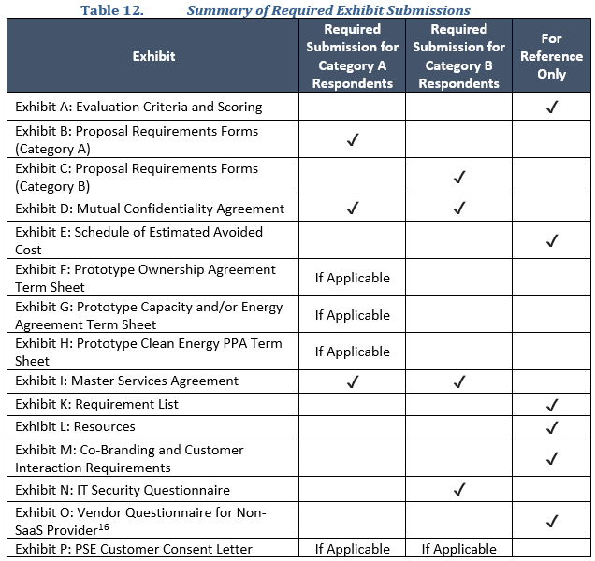
Proposal Requirements
5
Proposal Requirements
Bidders must submit the following by 11:59 PST on March 21, 2022:
  Completed and validated Exhibit B or C forms
  Signed Exhibit D Mutual Confidentiality Agreement
  Redlined Exhibit I MSA
  Completed Exhibit N (if applicable)
  Redlined Prototype Term Sheet (Exhibits F, G, H) (if applicable)
  Exhibit P Signed PSE Customer Consent Letter (if applicable)
Submit bids electronically through newly developed web platform (https://rfp.pse.com/)
More information about completing Exhibits B/C and submission of proposals through the web platform later in the presentation

Slide 27
Bid Preparation Demonstration

Slide 28
Resources for Bidders
6
Proposal Requirements
RFP website (www.pse.com/rfp)
Schedules for the All-Source and Targeted DER RFP
RFP mailbox (DERRFPmailbox@pse.com)
All questions related to the DER RFP (periodic Q&A postings to website for benefit of all)
Web portal for submittal of proposals (https://www.rfp.pse.com)
Accessible through the public website (www.pse.com/rfp)
Updates and notifications
Unlimited access to submit and resubmit proposals during RFP submission window
User manual, with support through RFP inbox available to bidders
Questions about the Targeted DER RFP may be sent to DERRFPmailbox@pse.com
Bates White (Independent Evaluator)
PSE interconnection contact information on home page of OASIS website (http://www.oatioasis.com/psei/). Updated tech specs for small generation interconnection can be found in the folder “PSE TECH SPECS FOR INTERCONNECTION” under the file name “Tech Spec for NonJurisdictional Small Gen Interconnection”
PSE interconnection website (http://www.oatioasis.com/psei/)
Frank Mossburg: frank.mossburg@bateswhite.com
Vincent Musco: vincent.musco@bateswhite.com
BPA transmission contacts: https://www.bpa.gov/Contact/Pages/Contact-Information-Transmission.aspx
Additional resources such as ArcGIS, third-party assistance and link to interconnection specs portal
Complete RFP documents for download

Slide 29
Q&A

Slide 30
Appendix

Slide 31
CEIP Preferred Portfolio
PSE 2021 CEIP Preferred Portfolio
Program | Program Description | Structure
PSE Customer-sited Solar+Storage Offering | PSE enrolls customers’ solar + storage systems in an incentive program that can offset customers' load from the grid in response to operating settings or dispatch signals from PSE | Incentive Payment
C&I Roof-top Solar Incentive | PSE offers upfront incentive to commercial customers, discounting their upfront cost to install and own distributed solar generation throughout service territory. | Incentive Payment
3rd Party Distributed Solar PPA | 3rd party installs/provides rooftop solar panels to customers throughout service territory. PSE off-takes RE via PPA or net metering while the 3rd party is responsible for managing program and financing equipment. | PPA
Residential PSE Battery Leasing + Targeted LI | PSE installs batteries in customer homes. Customers pay a fee for backup power services; PSE uses battery to manage system/local peaks. | Ownership
Residential Roof-top Solar Leasing + Targeted LI | PSE offers to lease residential customers' rooftop space to install solar PV. Customer receives a recurring lease payment; PSE generates RE to supply grid. | Ownership
Multi-Family Solar Partnership | PSE facilitates installation of solar PV at MFU buildings by connecting with technology providers and/or billing support to share production across units. | PPA/Ownership/Incentive
Additional Community Solar (MF Focus) | PSE offers customers the ability to subscribe to the output of solar panels. Customers pay a monthly fee and receive a monthly credit for generation. | Ownership
C&I Space for Batteries - Leasing | PSE leases space from/at C&I customers to deploy BESS to improve power quality and/or resiliency and manage system/local peak. Backup power for host customer as additional integration. | Ownership
Demand Response Programs | Programs utilizing technologies to reduce customer loads during peak load events. | Performance Contract
Source: PSE

Slide 32
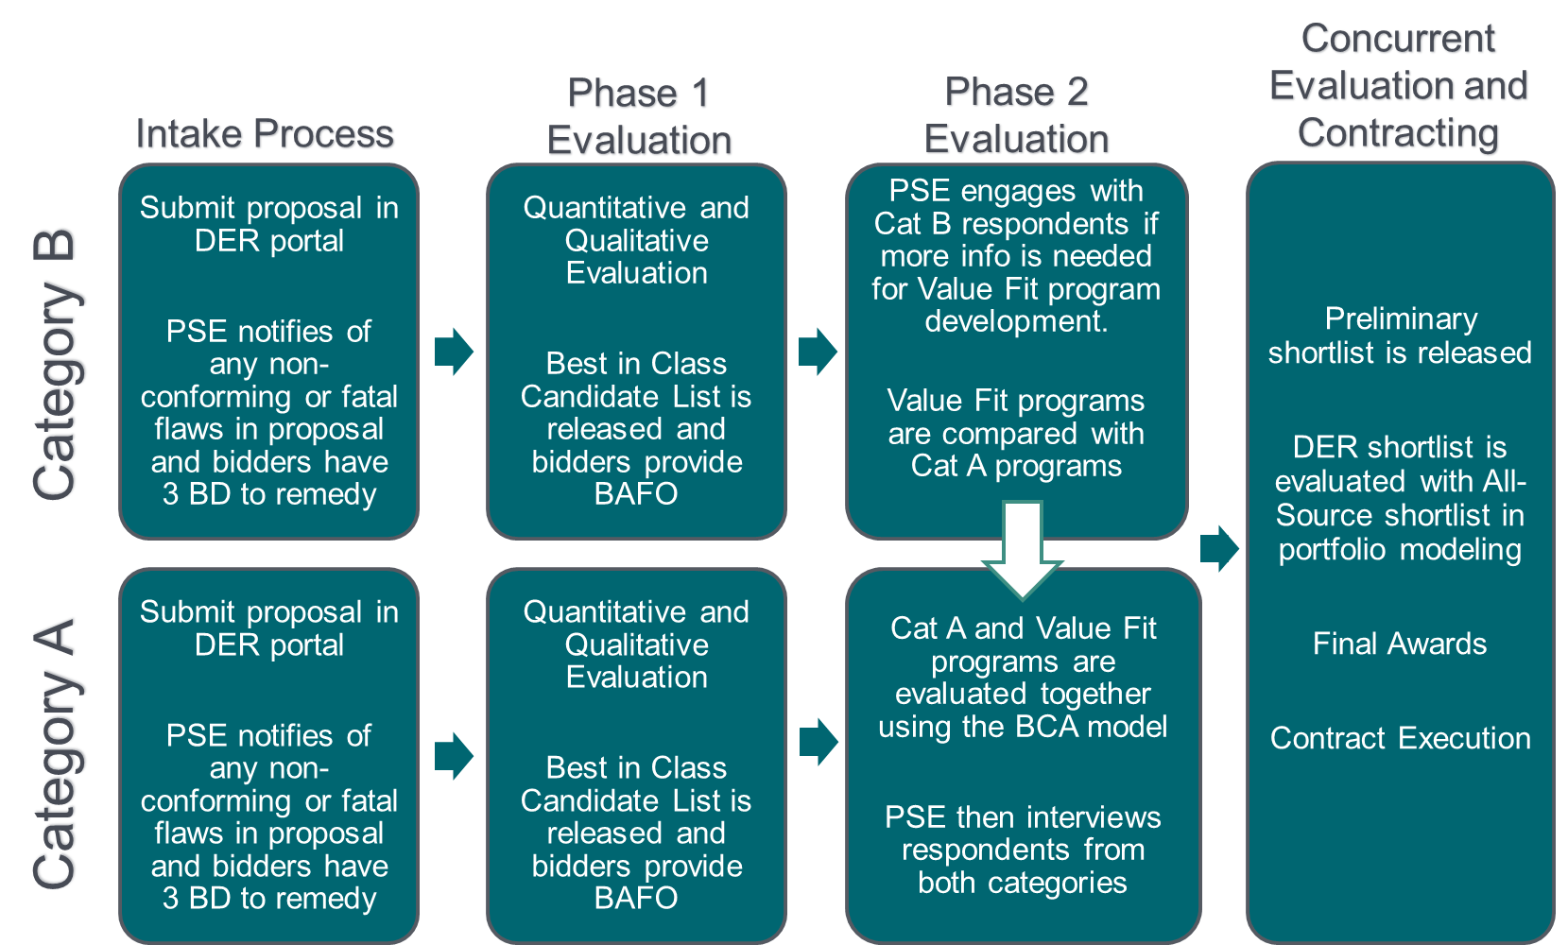
Evaluation Process

Slide 33
Category A – CETA Equity Plan, Customer Benefits (1 of 2)

Slide 34
Category A – CETA Equity Plan, Customer Benefits (2 of 2)

Slide 35
Category A – CETA Equity Plan, Business Values and Named Communities

Slide 36
Category B – CETA Equity Plan, Customer Benefits (1 of 2)

Slide 37
Category B – CETA Equity Plan, Customer Benefits (2 of 2)

Slide 38
Category B – CETA Equity Plan, Business Values

