Slide 1

Resource Tracking in Beeline

Slide 2
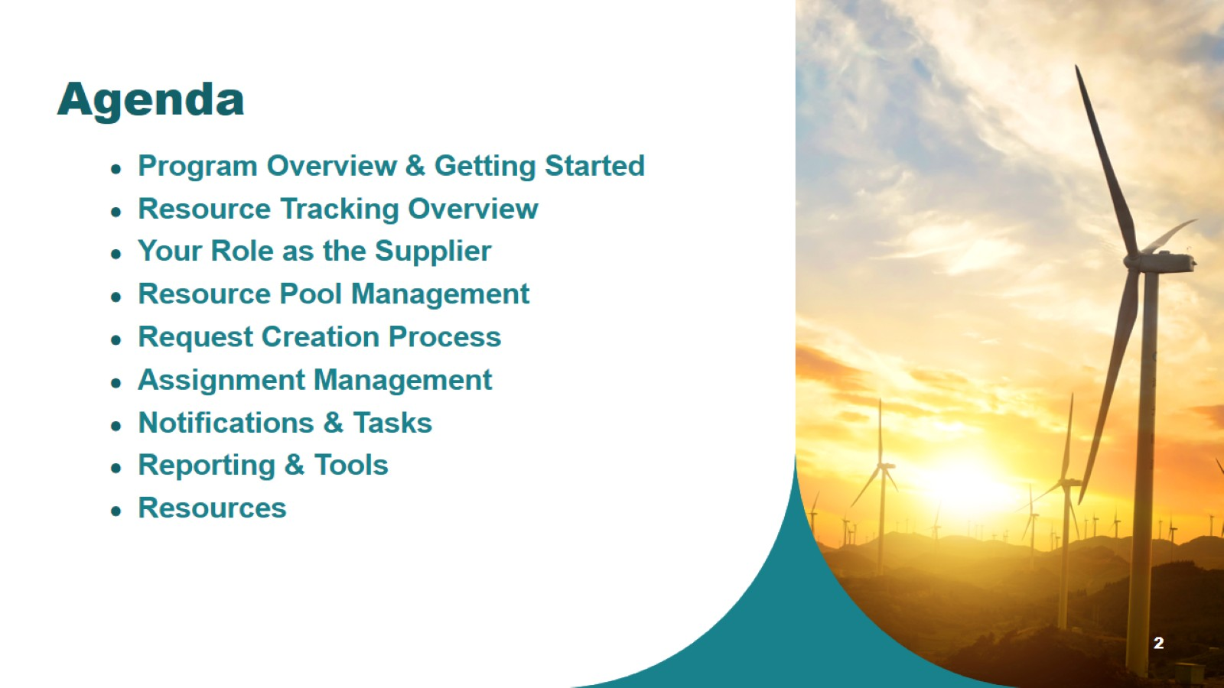
Agenda

Slide 3

Program Overview & Getting Started

Slide 4
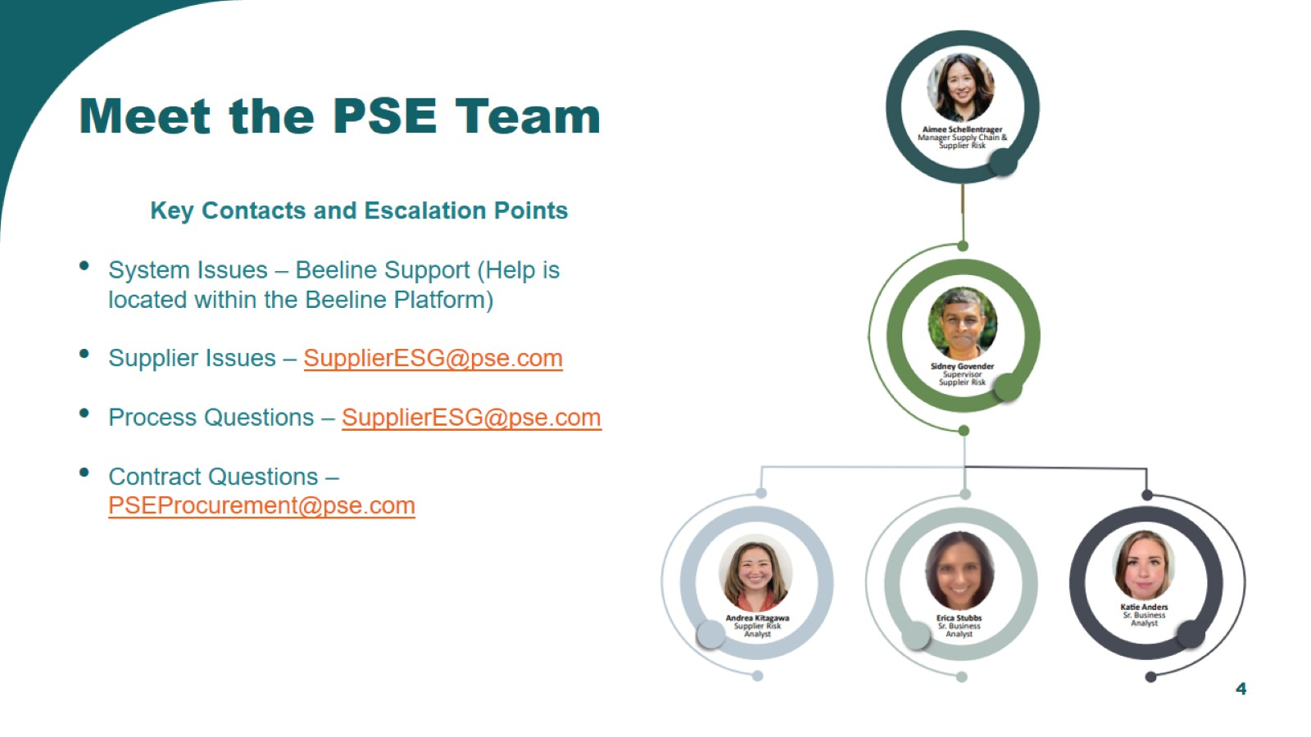

Slide 5
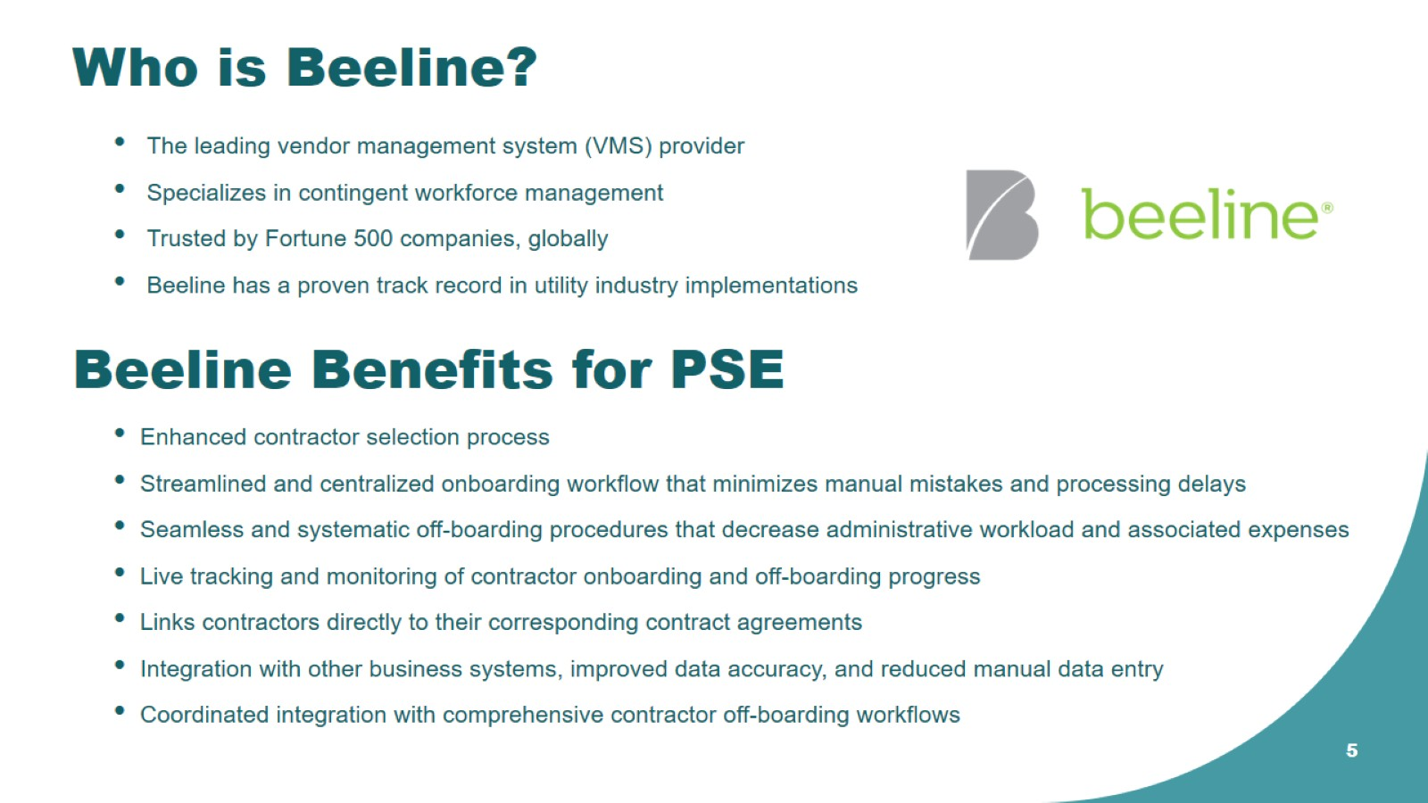
Who is Beeline?

Slide 6
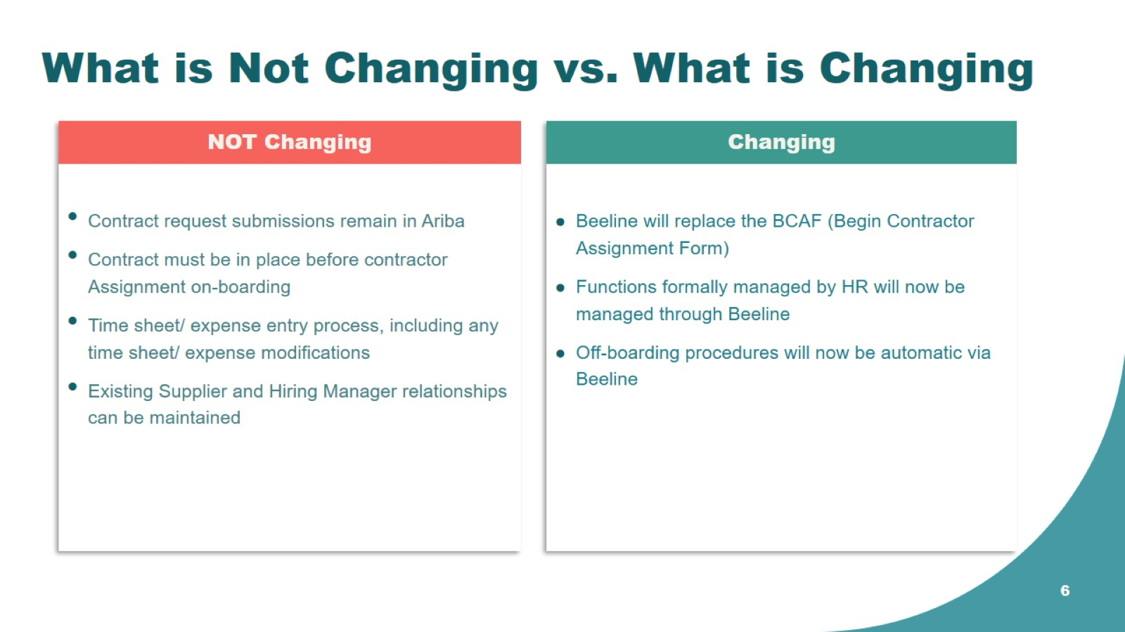
What is Not Changing vs. What is Changing

Slide 7
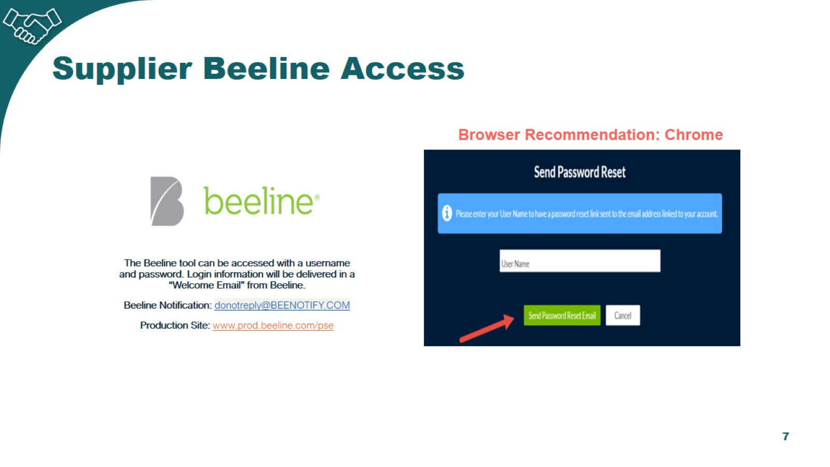
Supplier Beeline Access

Slide 8
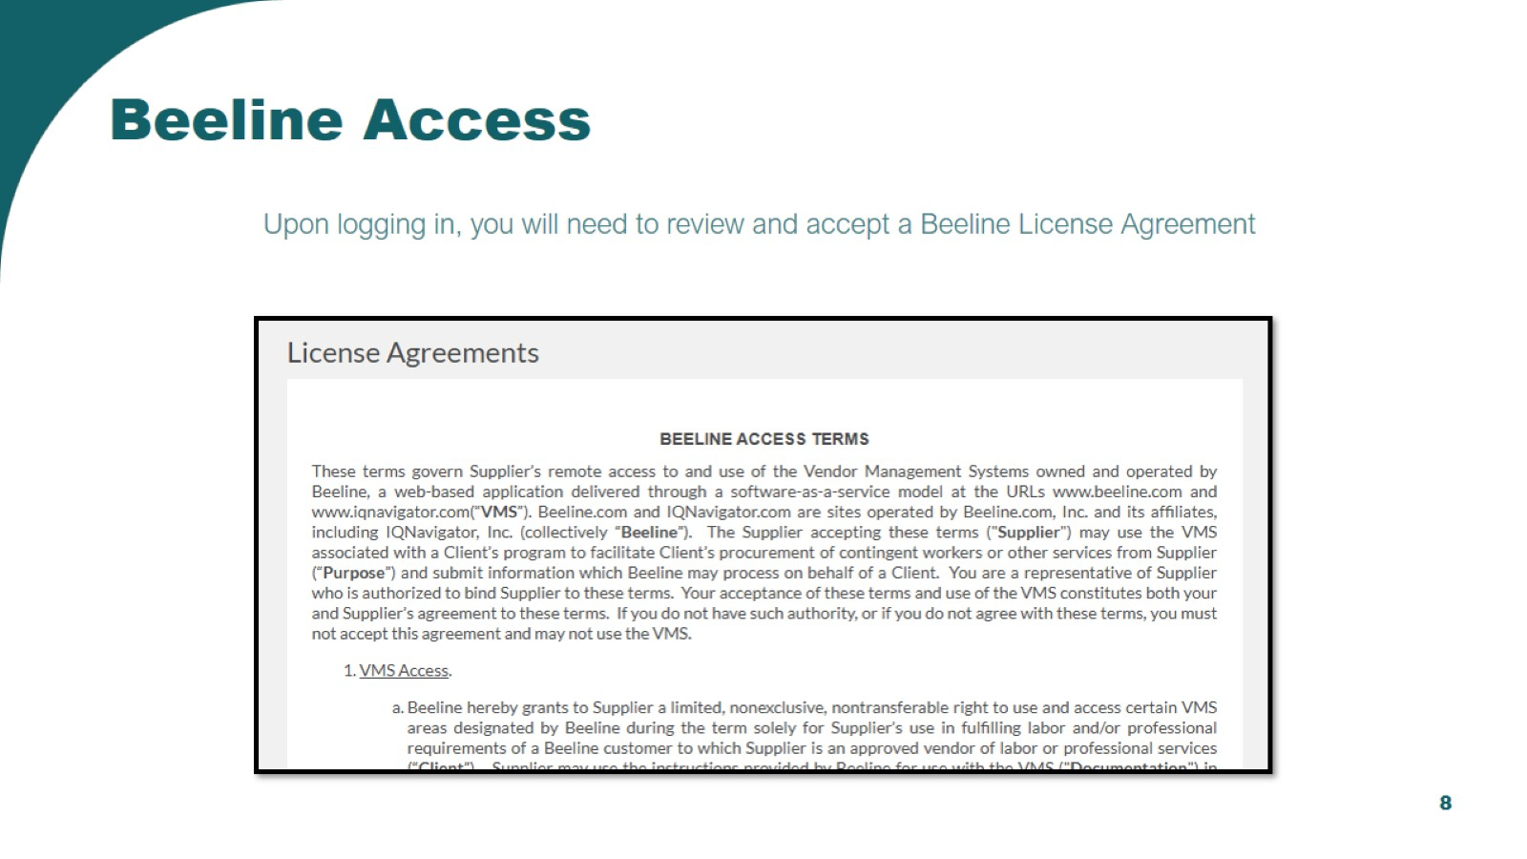
Beeline Access

Slide 9
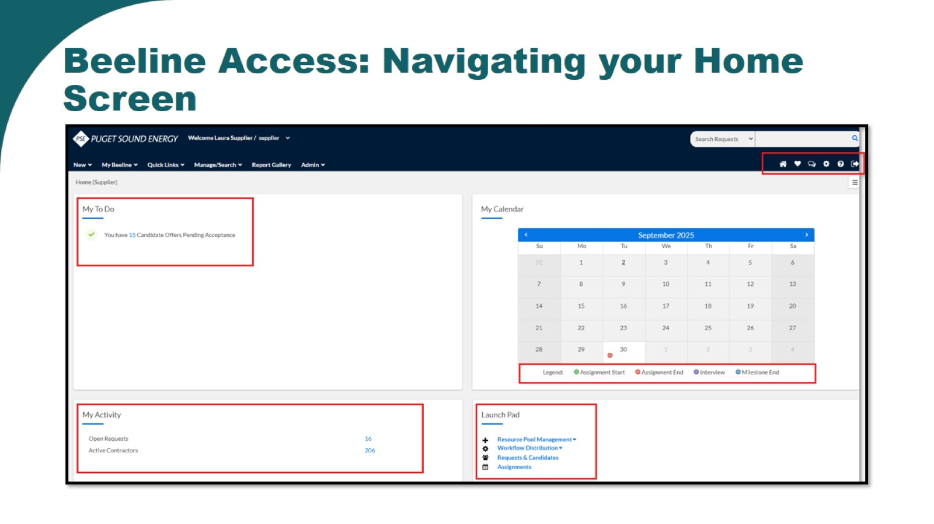
Beeline Access: Navigating your Home Screen

Slide 10

Resource Tracking Overview

Slide 11
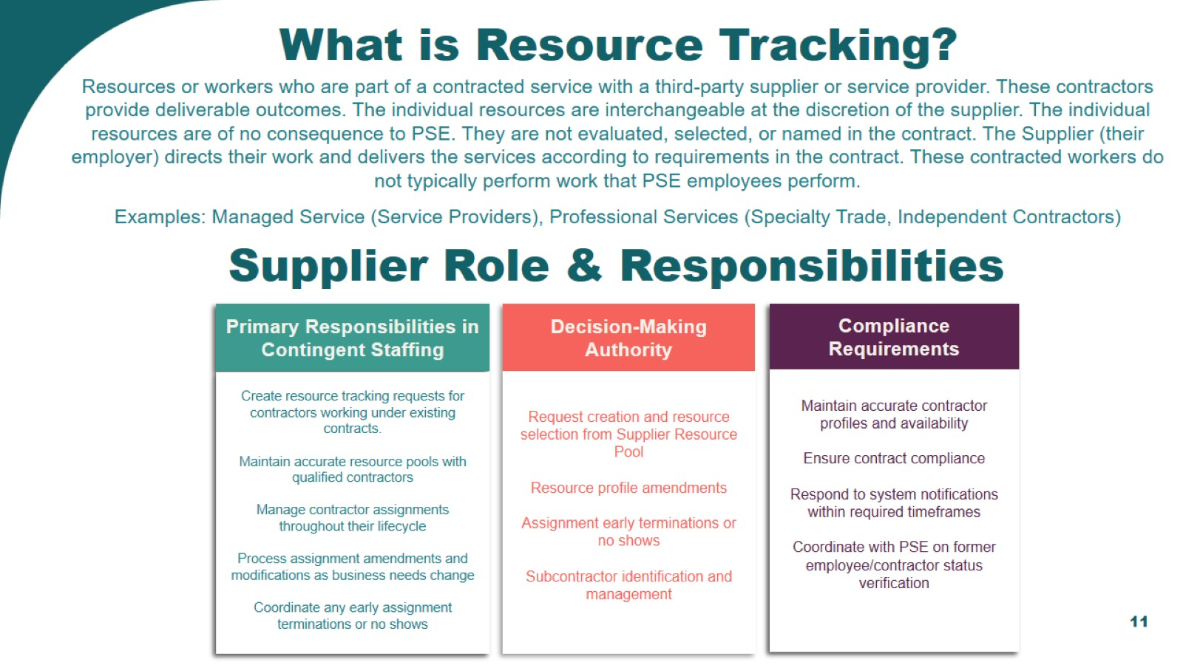
What is Resource Tracking?

Slide 12

Resource Pool Management

Slide 13

System Demonstration

Slide 14
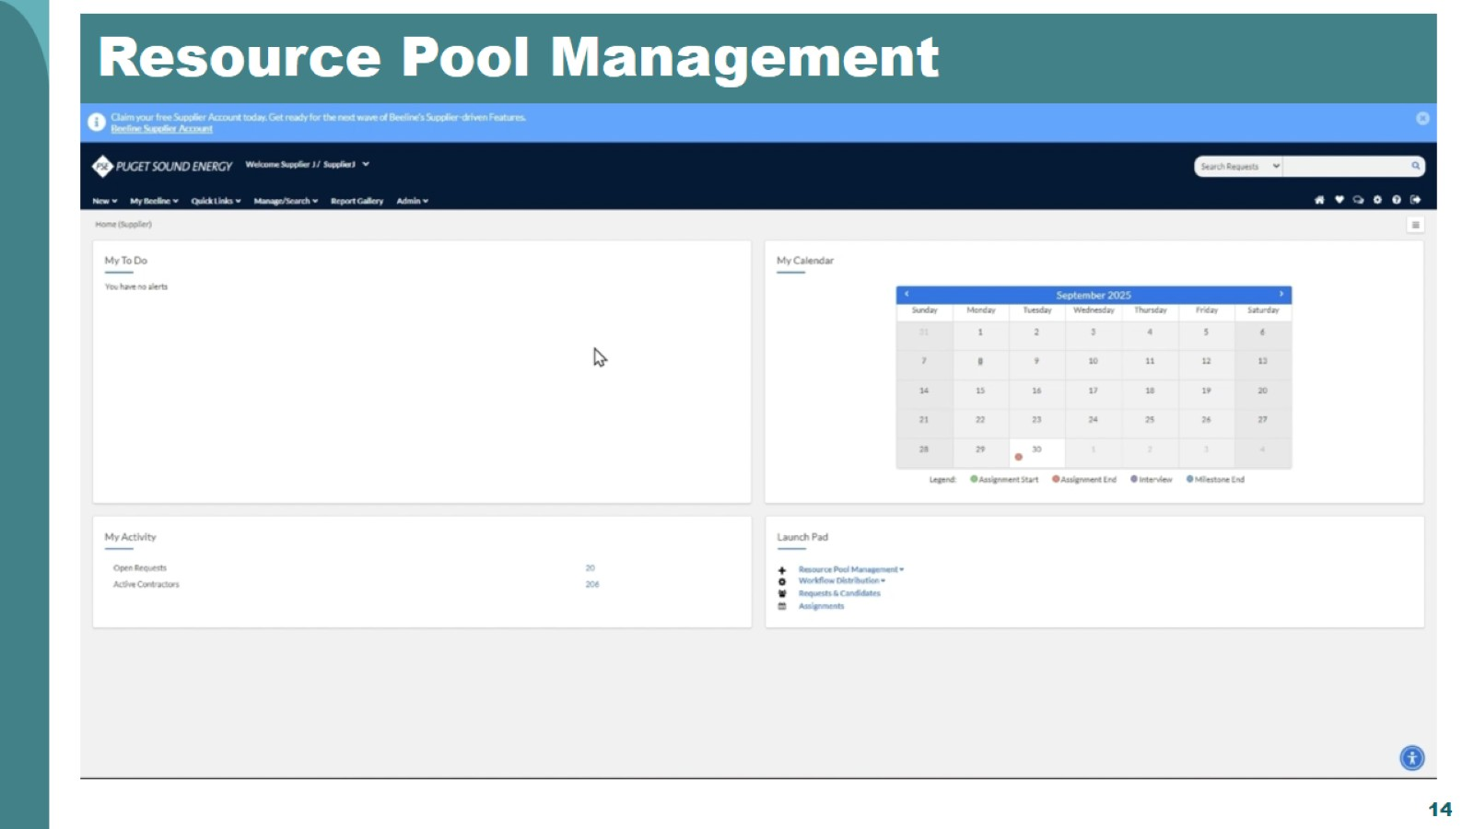
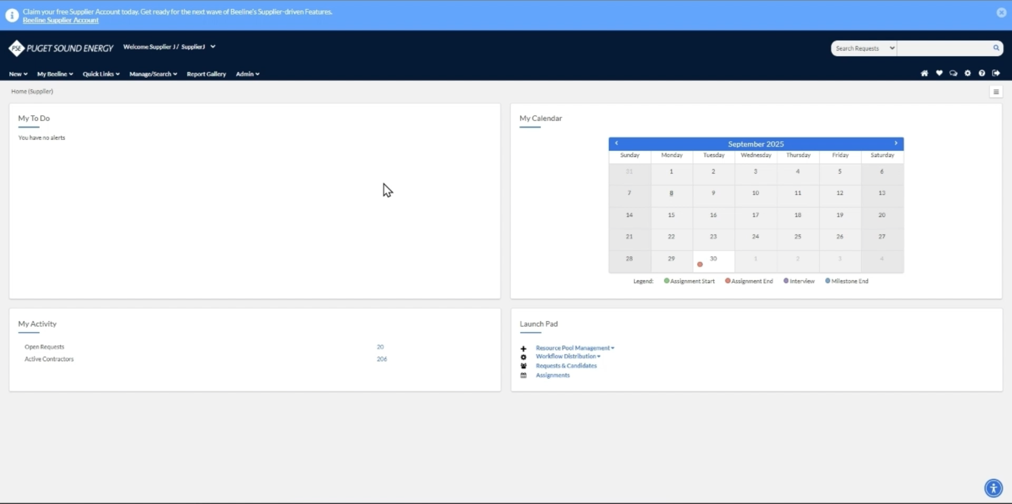
Resource Pool Management

Slide 15

Request Submission

Slide 16
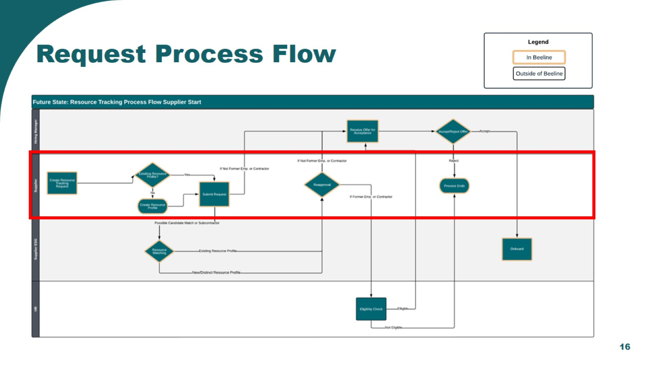
Request Process Flow

Slide 17
System Demonstration

Slide 18
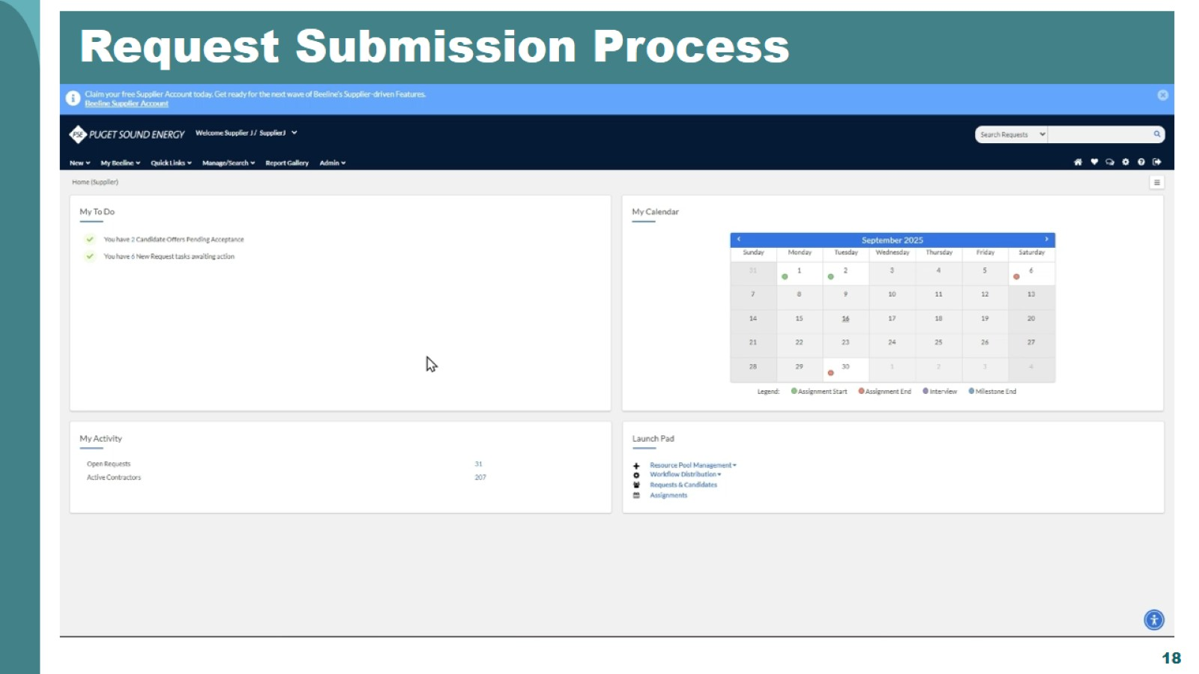
Request Submission Process

Slide 19
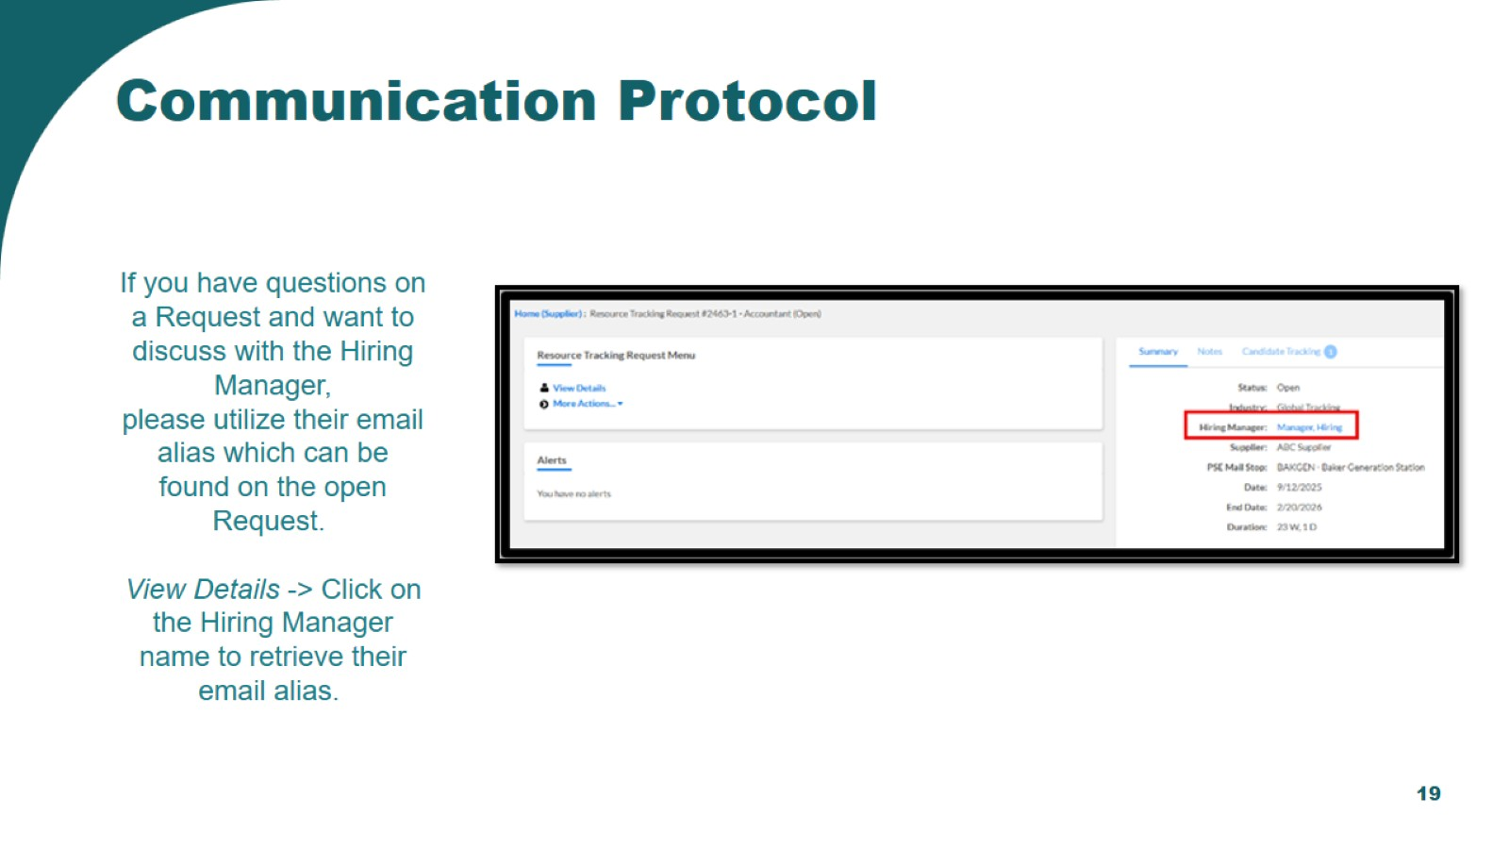
Communication Protocol

Slide 20

Onboarding Process

Slide 21
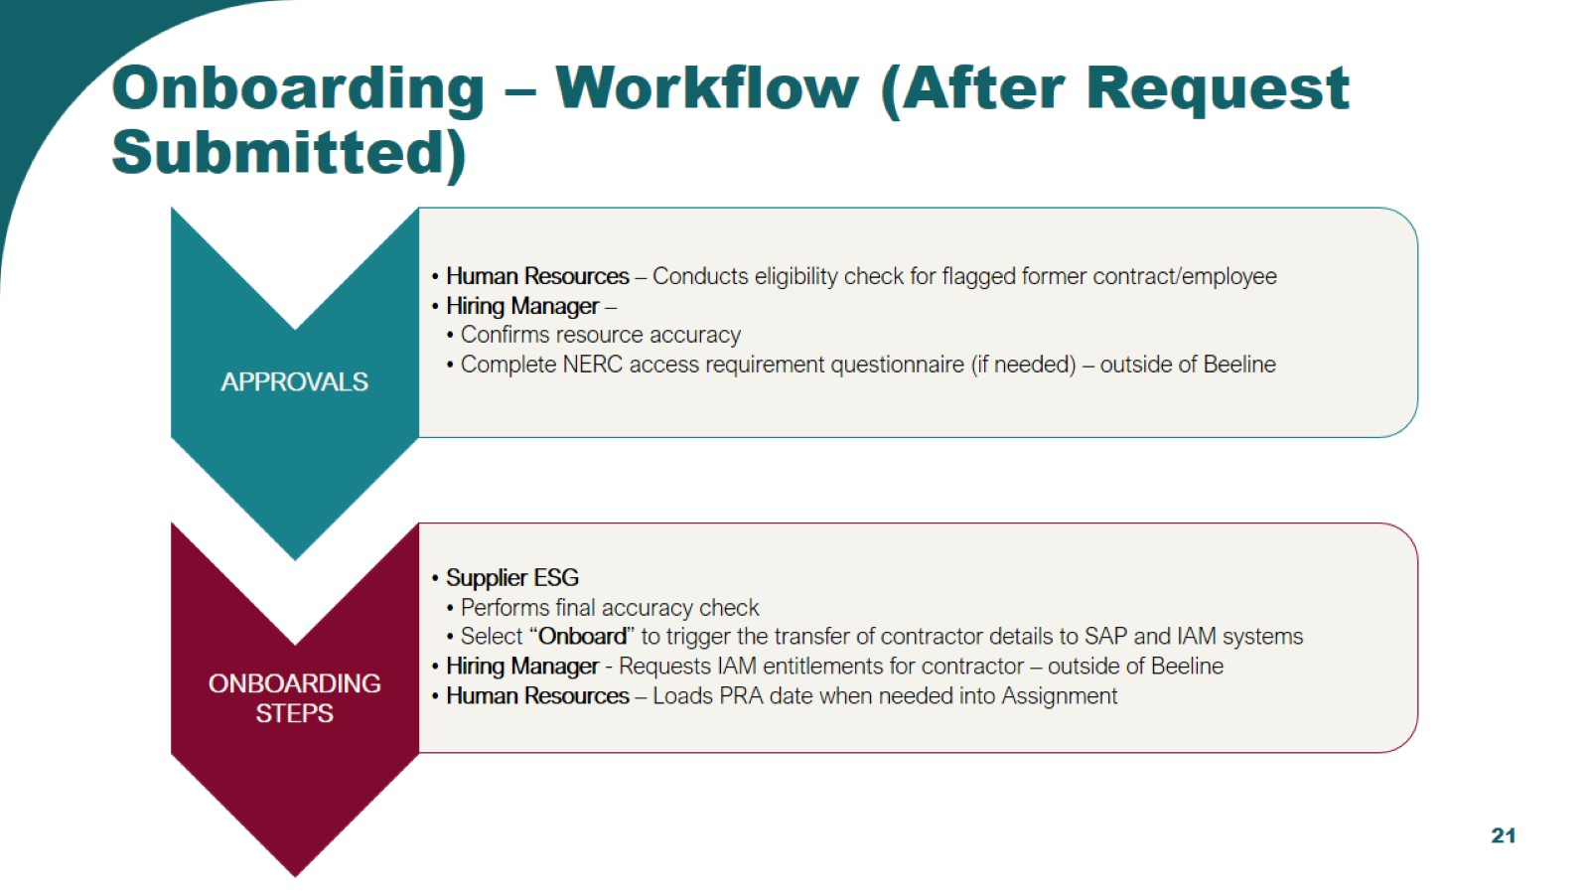
Onboarding – Workflow (After Request Submitted)

Slide 22
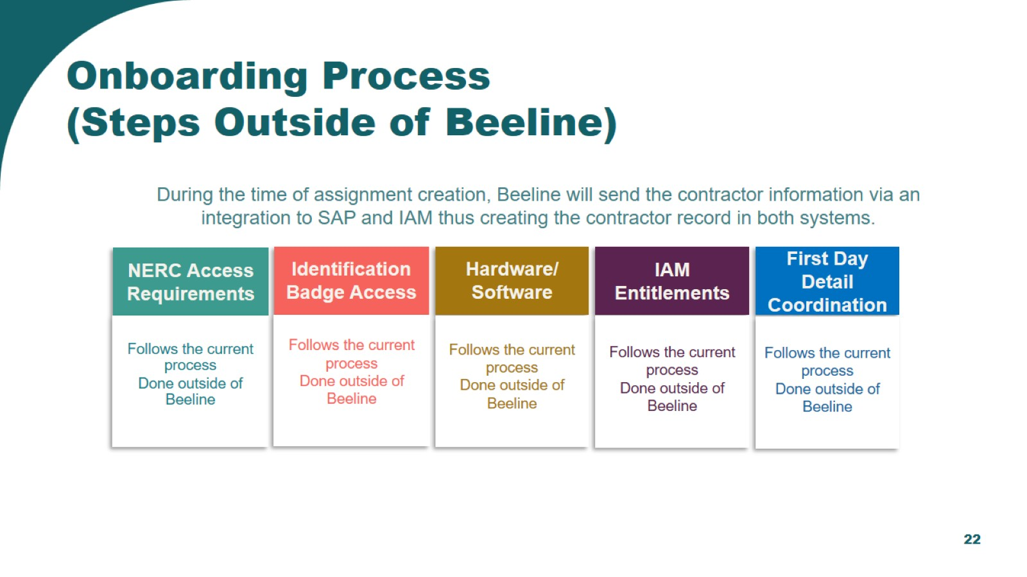
Onboarding Process
(Steps Outside of Beeline)

Slide 23

Assignment Management

Slide 24
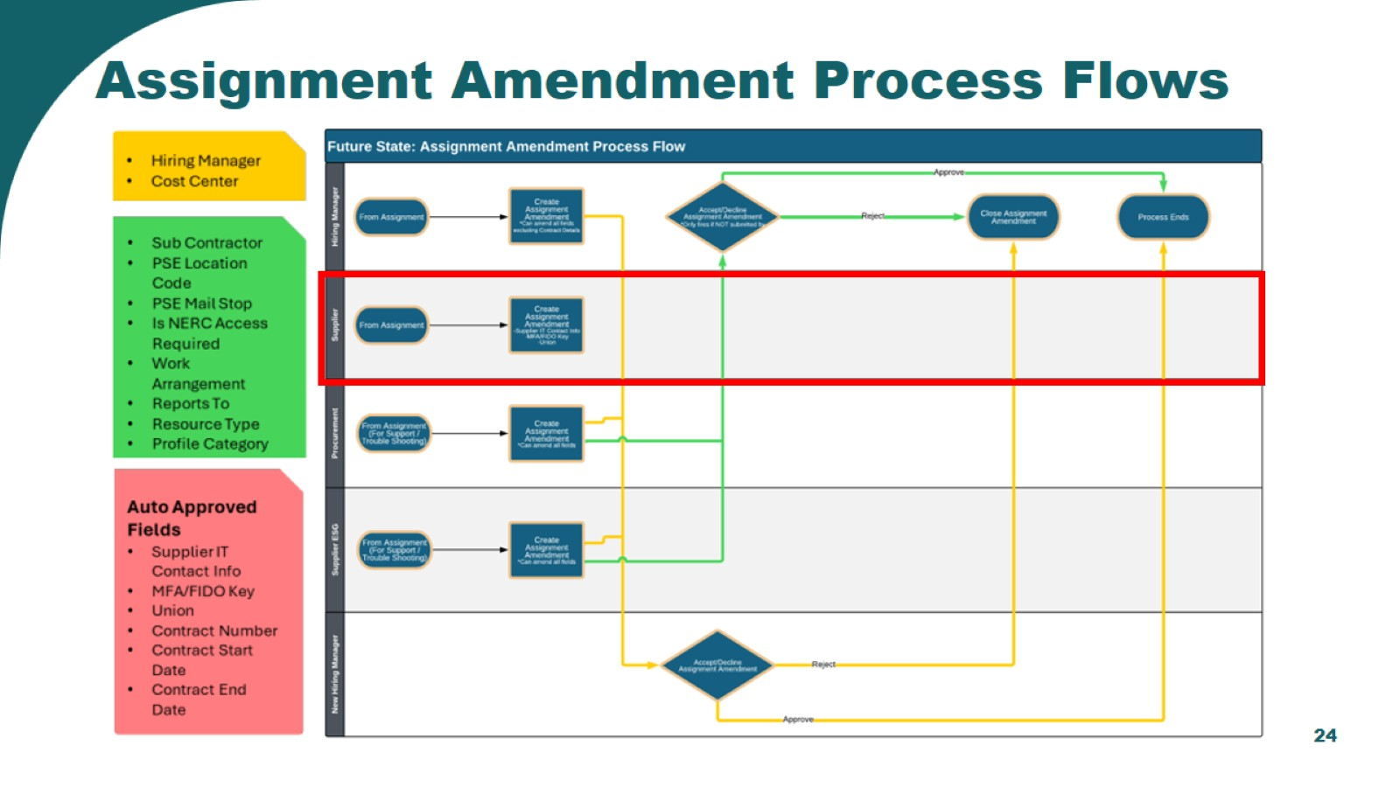
Assignment Amendment Process Flows

Slide 25
System Demonstration

Slide 26
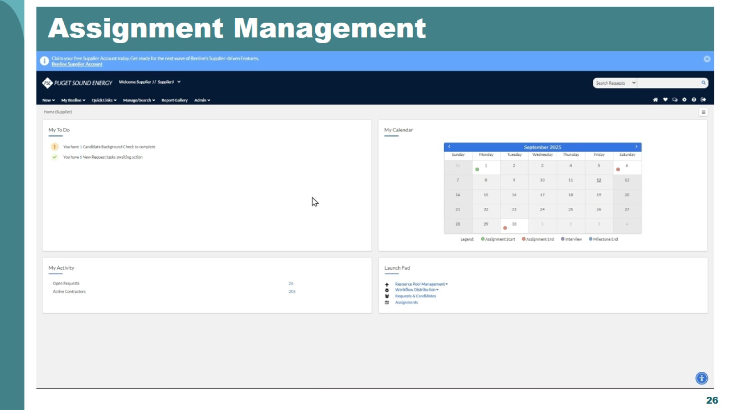
Assignment Management

Slide 27

Extensions

Slide 28
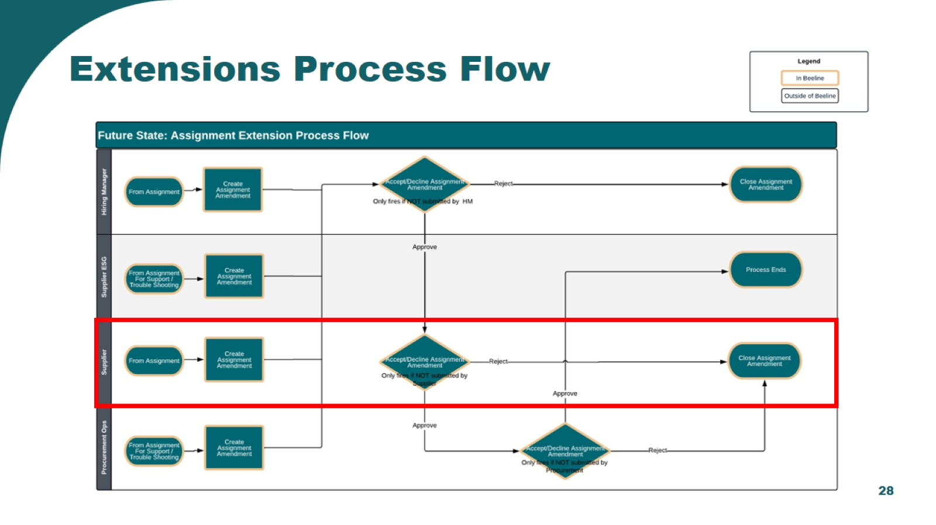
Extensions Process Flow

Slide 29
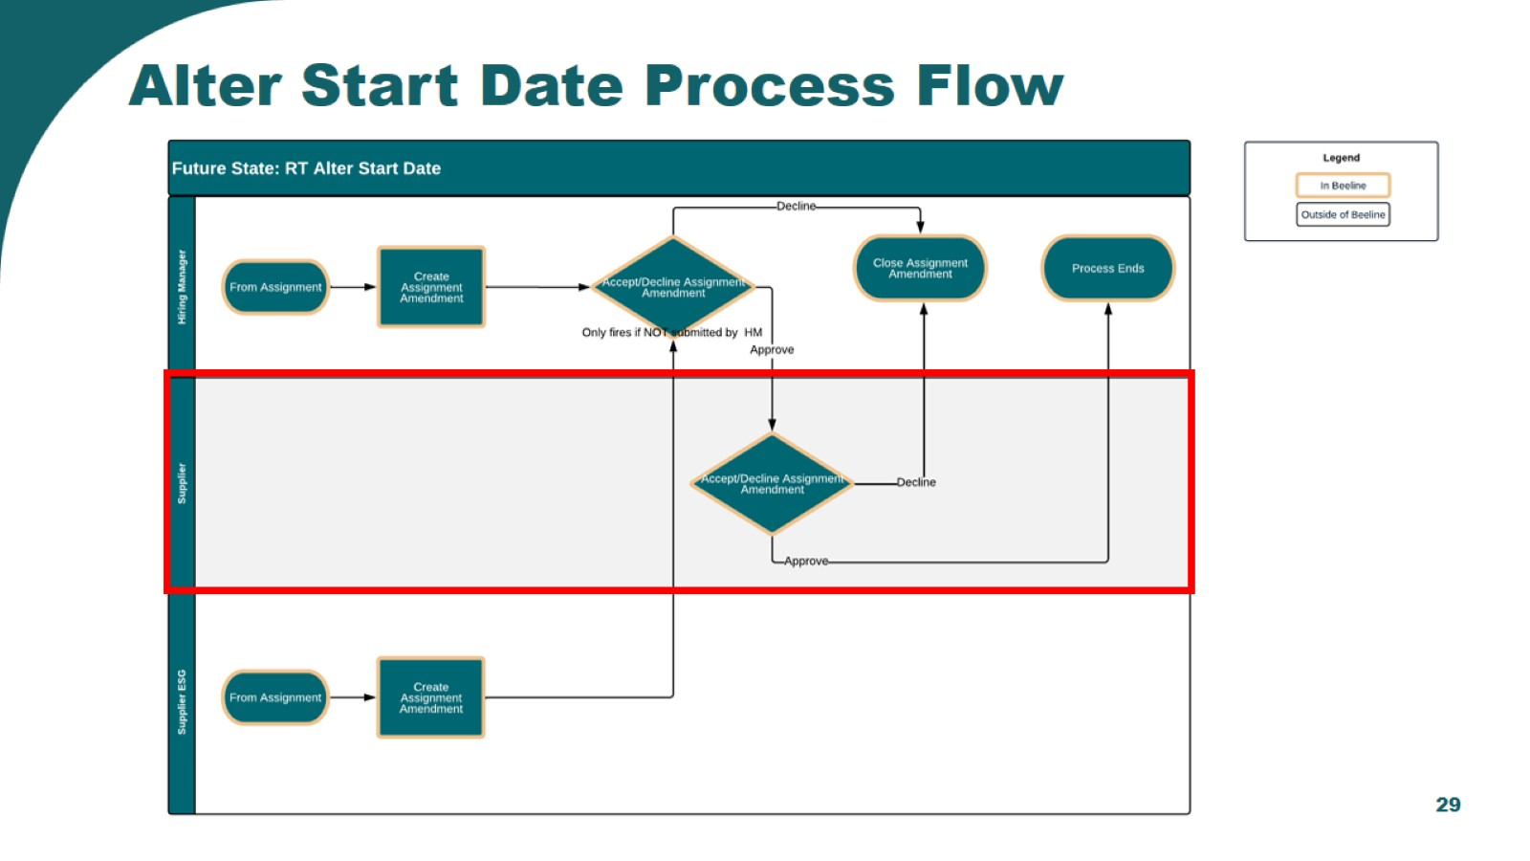
Alter Start Date Process Flow

Slide 30

System Demonstration

Slide 31
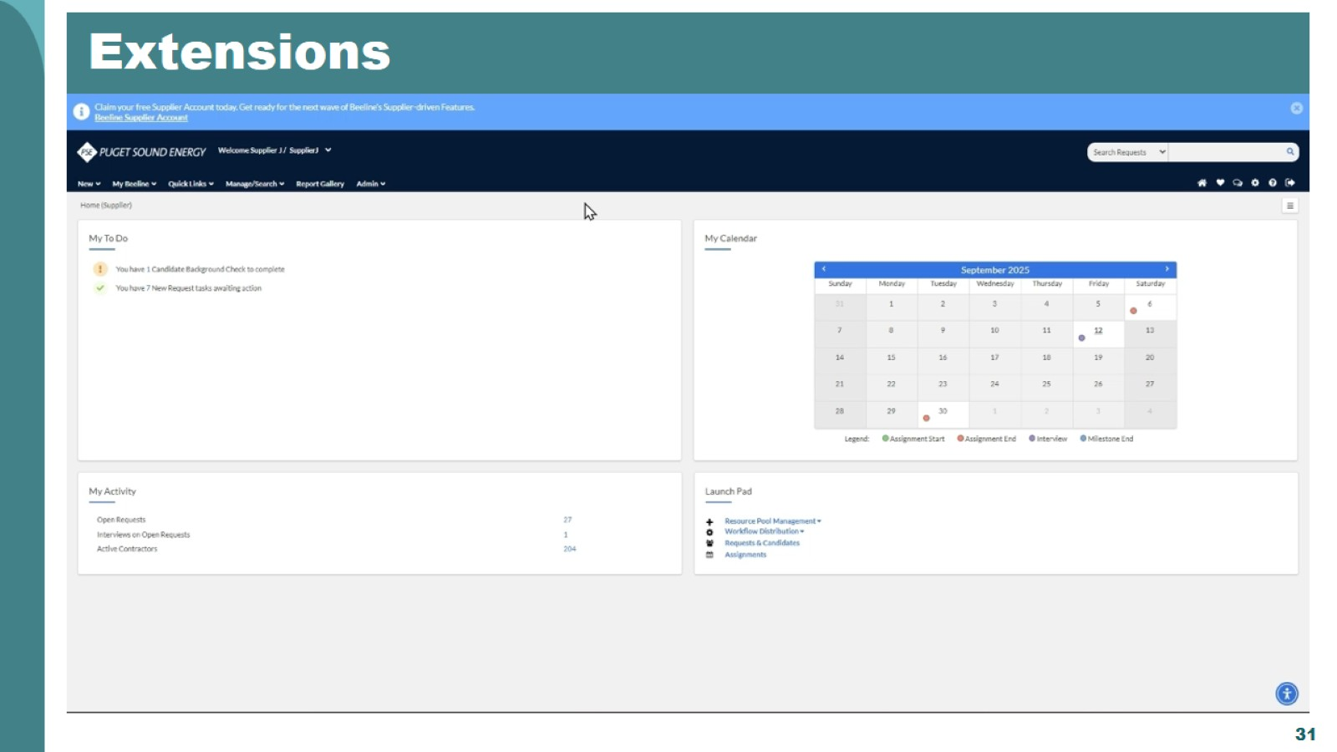
Extensions

Slide 32

Assignment Terminations

Slide 33
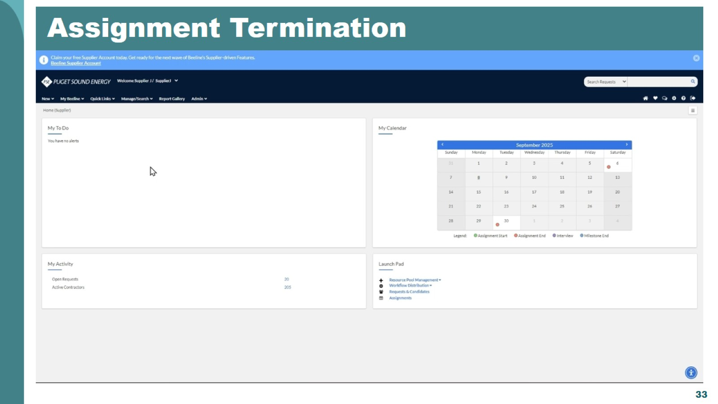
Assignment Termination

Slide 34
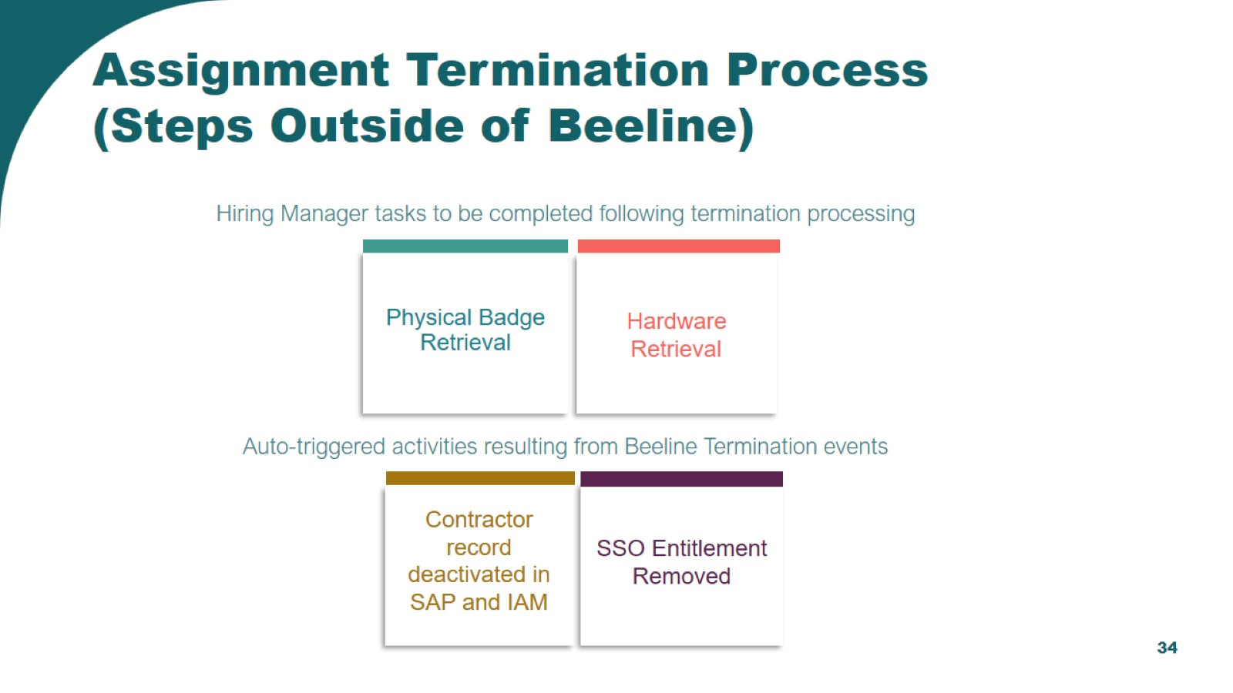

Slide 35

Notifications
& Tasks

Slide 36
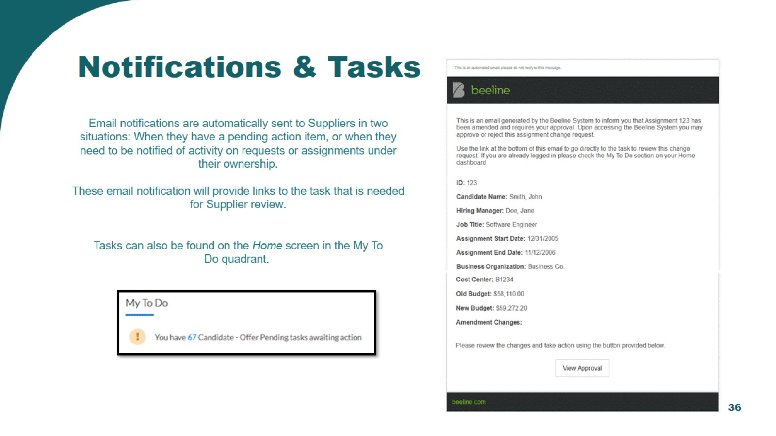
Notifications & Tasks

Slide 37

Reporting & Tools

Slide 38
System Demonstration

Slide 39

Reporting

Slide 40

Tools

Slide 41
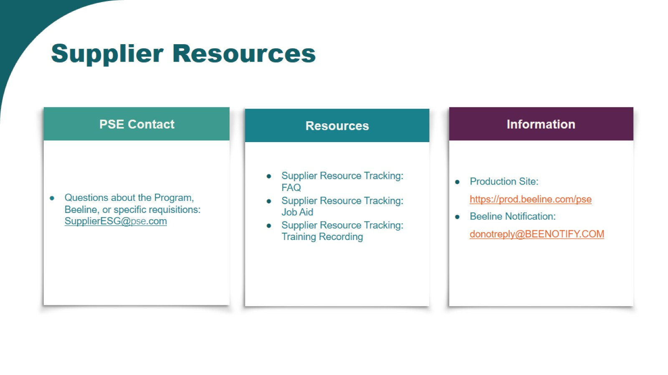
Supplier Resources

Slide 42

Thank you

