Slide 1

2023 Electric Progress Report
Elizabeth Hossner, Manager, Resource Planning and Analysis, PSE
June 26, 2023

Slide 2
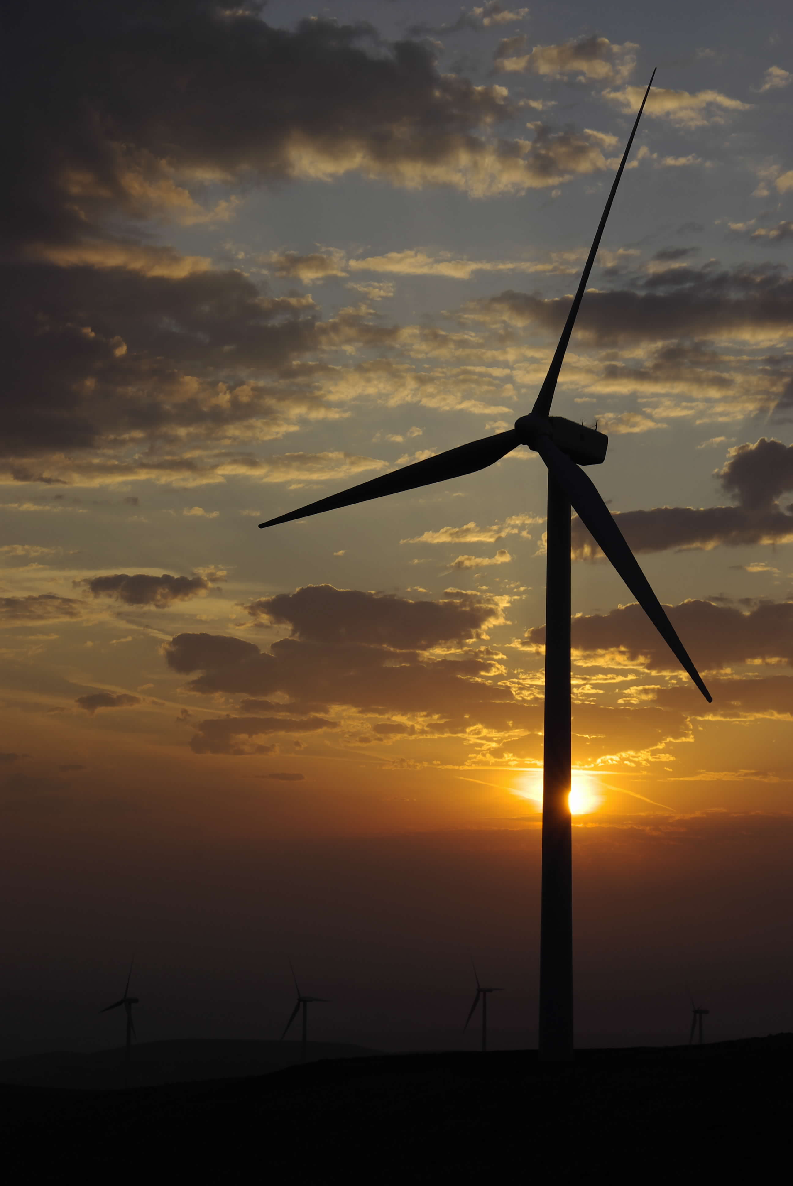
Highlights
PSE is committed to reaching the goals of the Clean Energy Transformation Act (CETA) and achieving carbon neutrality by 2030 and carbon free electric energy supply by 2045. The electric resource plan presented reflects these changes and goals. It includes:
Significant investments in renewable resources
Acquiring conservation resources
Developing and refining methods to embed equity into resource decisions
Pursuing demand response programs
Integration of distributed energy resources like residential solar and battery energy storage
Reduced reliance on short-term market purchases in response to the changing western energy market
Inclusion of alternative fuels to operate new generating plants
Exploring new capacity options to drive diversity in energy supply

Slide 3
New challenges and opportunities
Climate Commitment Act (CCA)
Climate Change modeling for demand and hydro generation
Reliability amidst lots of renewable resources
Electrification analysis and coordination with the gas portfolio
Inflation Reduction Act
Quantifying customer benefits
Resource Adequacy modeling for two peaks: Winter & Summer

Slide 4
Resource planning foundations
This 2023 Electric Report is a planning exercise that evaluates how PSE will meet customer electric supply needs. The analysis considers policies, costs, changing economic conditions, and the existing energy system to develop a plan to meet the needs of our customers at the lowest reasonable cost over the next 20+ years.
Key objectives, which lay the foundation for this and all future resource plans:
Build a reliable, diversified power portfolio of non-emitting resources
Ensure an equitable clean energy transition for all PSE customers
Ensure resource adequacy while delivering a clean energy transition
Ensure resource planning aligns with PSE’s Clean Energy Implementation Plan (CEIP) to meet our interim targets

Slide 5

Public participation snapshot
Access through online webinars and recordings
14
64
135
251
IRP webinars recorded and posted online
Average number of webinar participants
Organizations participated in webinars
Unique individuals participated in webinars
Online interested party feedback
E-newsletter communication
45
10
29
1,210
Feedback forms received and responded to
Email communications distributed
Feedback reports prepared
Interested parties opting to receive IRP newsletter
irp@pse.com
pse.com/irp

Slide 6
How public feedback shaped our work
Reduced market reliance
Incorporated climate change data and modeled winter and summer demand
Considered a range of resource alternatives and emerging technologies
Modeled battery cycling at various frequencies, capacities, and types
Modeled hybrid renewable and energy storage resources
Incorporated Inflation Reduction Act*
Embedded equity
Excluded small modular nuclear (SMR) from final portfolio
*Multiple public participation participants urged PSE to incorporate demand-side resource impacts as well. These federal programs are still taking shape and PSE does not have enough information to model these impacts. Therefore, in this IRP, we were not able to analyze how those layers of subsidies might affect customer decisions with regard to retaining or replacing appliances.

Slide 7


PSE currently has just over 6,000 MW nameplate of owned and contracted electric generating resources
1,905 MW
PSE’s Current Electric Generating Resources
Hopkins Ridge
Encogen
Ferndale
Fredonia
Whitehorn
Frederickson
Upper Baker
Lower Baker
Wells
Rock Island
Rocky Reach
Wanapum
Priest Rapids
Snoqualmie Falls
Lower Snake River 1
Wild Horse
Klondike III
Clearwater
Golden Hills
Skookumchuck
Lund Hill
Owned
Contracted
Green Direct
Owned
Mid-C contracts
Combined Cycle
Peaker
Frederickson
Colstrip 3&4
Coal Transition PPA
Energy Keepers
SPI Biomass
PG&E exchange
Schedule 91
PURPA Qualifying facilities
Goldendale
Mint Farm
Sumas
1,659 MW
966 MW
806 MW
750 MW
Thermal
Wind & Solar
Hydro
Long-term Contracts
Coal

Slide 8
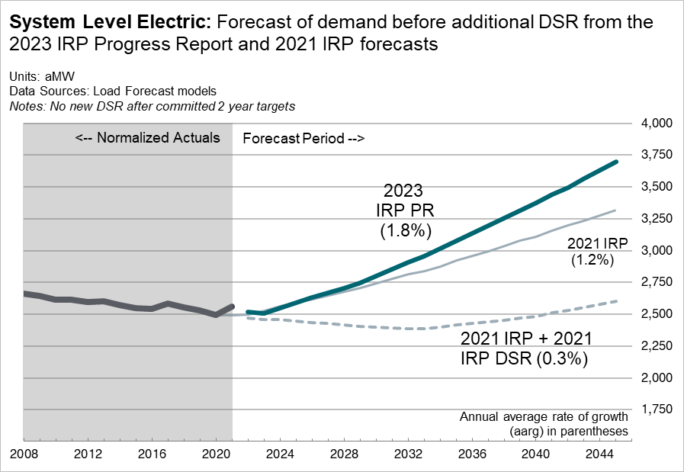
Energy demand forecast for 2023 Electric Progress Report
Demand lower by -0.4% in 2024 and higher by ~9% 2040.
Positive customer growth, steady use per customer (UPC), and EV growth yield demand growth, before DSR.​
Applying DSR will result in an “after DSR” forecast with lower growth than “before DSR.”​
Major updates: Normal Degree Days and EV forecast.
​

Slide 9
Changes in the preferred portfolio from 2021 IRP
Key Drivers for change in resource mix:
Increase in demand forecast results in increased builds
Market reliance shedding results in increased peak need and more builds
Updated resource adequacy modeling resulted in increased ELCC for energy storage
Updated resource costs result in shift toward hybrid resources
Updated Conservation Potential Assessment (CPA) changes value of conservation and results in less conservation.

Slide 10
Resource Additions | 2021 IRP |  | 2023 Progress Report
(Nameplate MW) | 2030 | 2040 | 2030 | 2040
Demand Side Resources | 758 | 1,221 | 618 | 1,094
Conservation¹ | 576 | 1,016 | 282 | 657
Demand Response | 182 | 206 | 336 | 437
Distributed Energy Resources² | 295 | 792 | 739 | 1,815
DER Solar | 260 | 723 | 552 | 1,567
DER Storage | 35 | 69 | 187 | 248
Supply Side Resources | 3,209 | 4,936 | 5,360 | 9,177
CETA Compliant Peaking Capacity³ | 255 | 729 | 711 | 985
Capacity Contracts | 979 | 979 | 0 | 0
Wind | 1,400 | 2,500 | 1,400 | 2,900
Solar | 400 | 498 | 699 | 1,894
Green Direct | 0 | 0 | 100 | 100
Hybrid (Total Nameplate) | 0 | 0 | 1,449 | 1,597
Hybrid Wind | 0 | 0 | 600 | 700
Hybrid Solar | 0 | 0 | 400 | 398
Hybrid Storage | 0 | 0 | 450 | 499
Biomass | 0 | 30 | 0 | 0
Nuclear | 0 | 0 | 0 | 0
Standalone Storage | 175 | 200 | 1,000 | 1,700
Total | 4,262 | 6,949 | 6,717 | 12,086
2023 Electric Progress Report
Preferred Portfolio
Conservation in aMW includes energy efficiency, codes and standards, and distribution efficiency.
Distributed Energy Resources (DER) storage and solar includes CEIP storage and solar additions, non-wires alternatives, distributed storage and solar additions, and net-metering solar.
CETA compliant peaking capacity is functionally similar to natural gas peaking capacity, but operates using non-emitting hydrogen or biodiesel fuel.

Slide 11
Electric generating resources need estimated to almost double by 2030
+ 15,000 MW
new resources
By 2030 that’s equivalent to*…
+ 23 Wild Horse size wind projects
+ 5 Whitehorn size peaking facilities
+ 700 shipping containers for battery storage
~97 acres (4.2 million sq. ft.) double stacked
+ 35,500 residential solar installations
+ 450 school community solar projects
+ 190 commercial solar installations
+ 6,700 MW
new resources
6,000 MW
*Equivalent measures are illustrative

Slide 12
Meeting the CETA requirement in 2030
Preferred portfolio exceeds at least 80 percent of retail sales supplied with renewable and non-emitting energy based on ranges for load, wind, solar and hydro generation
Load reducing resources include
Conservation
Demand response
Voluntary renewable programs
Net-metering
Community solar
Green Direct
PURPA* contracts
*Public Utility Regulatory Policy Act (PURPA) qualifying facilities (QFs) are smaller generating units that use renewable resources, such as solar and wind energy, or alternative technologies, such as cogeneration

Slide 13
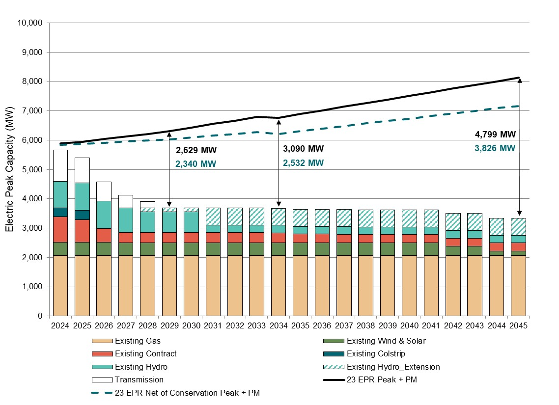
Winter peak driving effective capacity additions
Winter peak > summer peak through 2045
2,629 MW by 2029 is needed to achieve 5% loss of load probability.
Reduced to 2,340 MW after conservation
Renewable and energy storage peak capacity contribution is larger in the summer
New renewable and non-emitting resources will meet summer but not winter peaks
New peaking capacity resources are needed

Slide 14
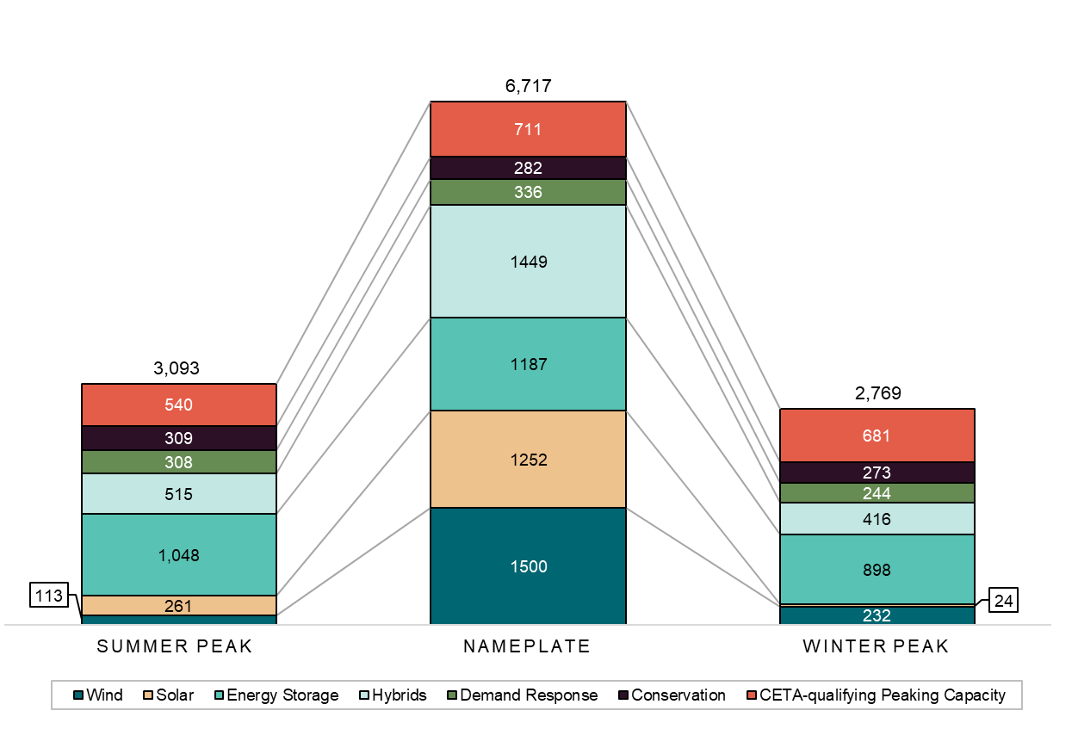
2030 nameplate vs. peak capacity
After adjusting for peak capacity contribution
6,717 MW installed nameplate capacity of new resources
=
3,093 MW summer peak capacity
=
2,769 MW winter peak capacity

Slide 15
Range of annual emissions for preferred portfolio
Includes CCA price in cost of dispatch for thermal resources and includes market sales and Transalta Coal Transition contract
Decline in emissions after 2025 from Colstrip and Centralia PPA expiration at the end of 2025
Decrease starting in 2030 through 2044 when natural gas and hydrogen fuel blending starts for existing and thermal resources
Any remaining emissions in 2045 are due to emissions from unspecified market purchase

Slide 16
Model updates for progress report
Climate change analysis
Social Cost of Greenhouse Gases
Portfolio Benefit Analysis
30 years of temperature data (rolling 15 years actual + 15 years forward)
Hydro generation data downscaled from the 3 climate models
2021 IRP used multi-step process to calculate SCGHG costs and then apply costs back into model for resource decisions
Progress Report used updated methodology to remove multi-step process and SCGHG is dynamically calculated with dispatch in the model for the resource decision
Measures potential equity-related benefits to customers within a given portfolio and the tradeoffs between those benefits and overall cost

Slide 17
The Clean Energy Transformation Act requires utilities to consider equity and ensure all customers benefit from the transition to clean energy
We expanded on our 2021 approach; will improve methodology for 2025 IRP and future CEIPs
Evaluated traditional least cost portfolio against customer benefit indicators (CBIs) in the Progress Report:
CBIs are equally weighted
Public provided great feedback on this methodology
Refined portfolio with goal of maximizing benefits and reducing burdens to vulnerable populations and highly impacted communities
The portfolio benefit analysis tool measures potential equity-related benefits to customers within a given portfolio and the tradeoff between those benefits and overall cost.
Portfolio benefit analysis

Slide 18
Customer Benefit Indicators (CBI)
Improved access to reliable, clean energy
measured by customers with access to distributed storage resources
Improved affordability of clean energy
measured by the total portfolio cost
Improved outdoor air quality
measured by sulfur oxides, nitrogen oxides, and particulate matter generated per portfolio
Increase the number of jobs
measured by the number of estimated jobs generated for each portfolio
Increase participation in Programs
measured by energy efficiency capacity added and the number of customers projected to participate in distributed energy resources and demand response programs
Reduced greenhouse gas emissions
measured by the total amount of CO₂-eq generated per portfolio
Reduced peak demand
measured by the decrease in peak demand achieved via demand response programs

Slide 19
Portfolio evaluation for customer benefits
Goal: Identify a feasible portfolio of diverse resources that prioritizes equity and creates customer benefits while maintaining reliability and affordability.
To create the diversified portfolio:
1. Start with the least cost reference portfolio
2. Make incremental changes to the portfolio to test the sensitivity of the adjustment to builds and portfolio cost
3. Create a portfolio with different options from part 2
Considerations: equity, cost, feasibility, reliability, and diversity of energy supply

Slide 20
Diversified Portfolios
Includes Nuclear SMR
No Nuclear SMR
Portfolio 11 A1
Least diversified
Conservation; MT Wind + PHES; Nuclear
Portfolio 11 B1
Least diversified
Conservation; MT Wind + PHES
Similar
Portfolio 11 A2
Add in PNW PHES
Portfolio 11 B2
Most diversified
Add in PNW PHES; DER Solar; DER Batteries; All DR Programs
Portfolio 11 A3
Add in DER Solar
Portfolio 11 A4
Add in DER Batteries
Preferred Portfolio
Similar
Portfolio 11 A5
Most Diversified
Add in all DR Programs

Slide 21
Portfolio Benefit Analysis
CBI results and 22-yr portfolio cost with SCGHG (2024 – 2045)
High CBI index for portfolio 11 B2
Improvements in all CBIs considered in this analysis except for jobs
The benefits include some of the highest potential customer participation numbers for
DER solar
DER storage
Demand response
Preferred Portfolio

Slide 22
Action plan
Renewable and Non-Emitting Resources
Participate in hydrogen research and development
Study biodiesel and renewable diesel availability and firm acquisition
Study advanced nuclear and other emerging technologies
Research and deploy energy storage
Examine repowering or upgrading existing generation
Distributed Energy Resources
Resource Deliverability
Expand distributed energy resources and demand response
Acquire energy efficiency
Expand regional transmission capacity

Slide 23
Thank you for attending
May 2023

Slide 24
Appendix
May 2023

Slide 25
Demand forecast updates and impacts
UPDATE
GENERAL IMPACT
CLIMATE CHANGE
Updated normal temperature assumptions reflecting continued warming over time
Decreases energy and peaks for heating and increases energy and peaks for cooling
ELECTRIC VEHICLES (EVs)
Includes impact of recent legislation and forecast of medium and heavy duty EVs
Increases electric energy and peak forecasts
ECONOMY & COVID
More optimistic economic outlook than assumed for 2021 IRP
Increases energy and peak forecasts
E.g., Incorporated recent actual customer counts and billed sales data, new major block loads
OTHER
Increases energy and peak forecasts

Slide 26

This is the first step for incorporating climate change into planning
Content presented today is PSE’s first step in reflecting climate change in the demand forecast and resource plan
We expect the methodologies and data available will continue to evolve over time
There are no industry standards or best practices for climate change assumptions. PSE is part of the EPRI Climate READi project which is focused on creating industry standards for using climate change data in utility planning processes.
This is a summary of the information presented to PSE’s stakeholder at the January 20th, 2022 meeting.

Slide 27
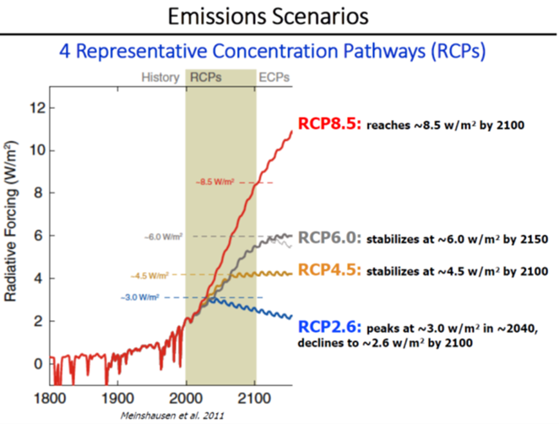
Climate change models for the region have been developed and used by the Northwest Power and Conservation Council
•A coalition including climate scientists, Bonneville Power Administration, US Army Corps of Engineers, and Bureau of Reclamation created climate models for the region
www.nwcouncil.org/2021powerplan_summary-climate-change-scenarios
•The Northwest Power and Conservation Council’s draft 8th Power Plan was issued in September 2021
www.nwcouncil.org/2021-northwest-power-plan
•The Council uses temperature projections downscaled for the region from three different Global Circulation Models

Slide 28

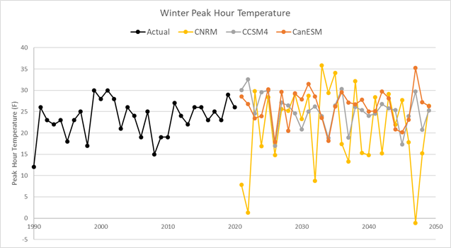
Electric peak hour temperature in winter increases
PSE used the same approach to determine updated normal peak temperatures
For electric normal peak, we used a 30-year centered rolling time period to determine "1-in-2 chance" peak temperatures

Slide 29
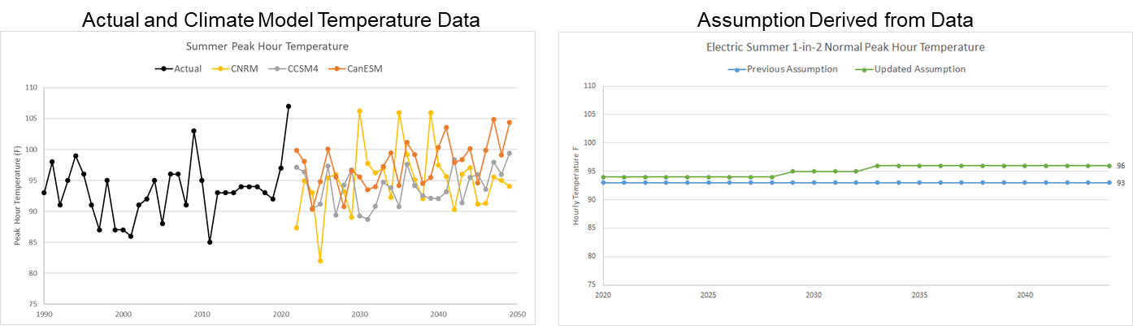
Electric peak hour temperature in summer increases

Slide 30
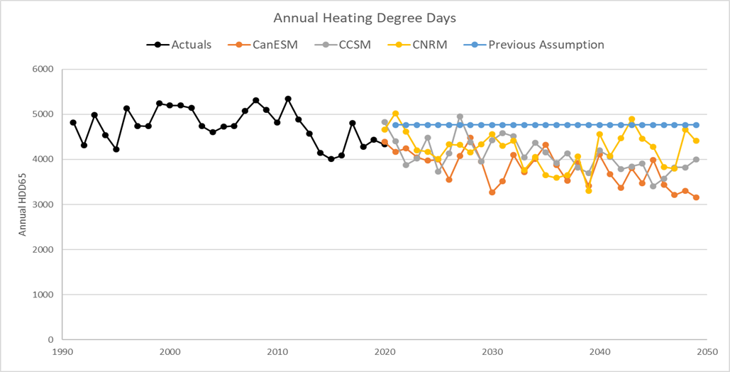
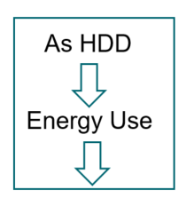
To explore the data, we calculated annual heating degree days from the climate model temperatures

Slide 31
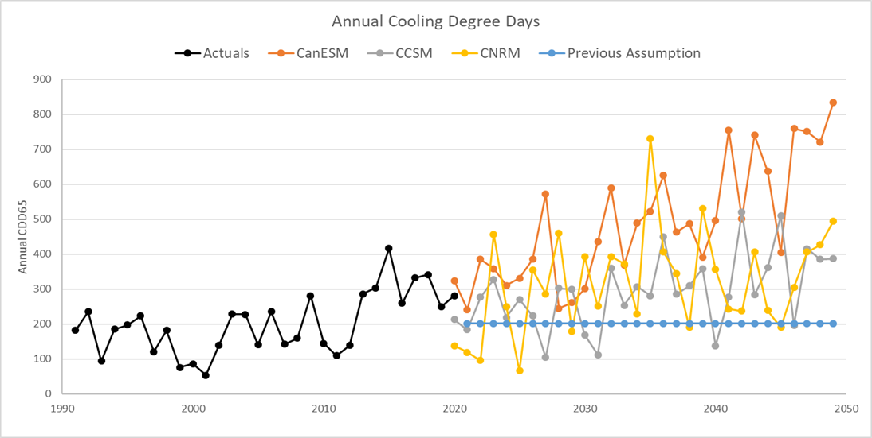
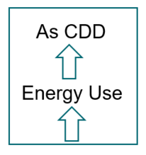
We calculated annual cooling degree days from the climate model temperatures

Slide 32
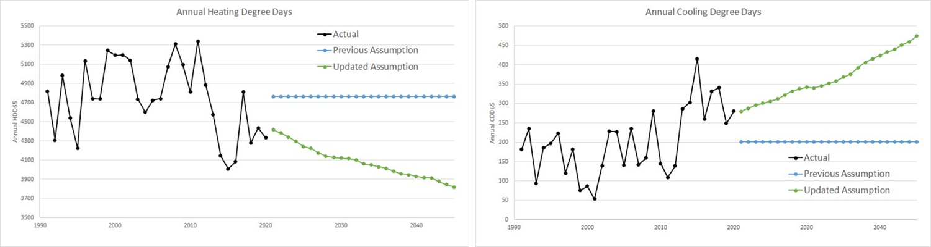
For energy modeling, we used a 30-year normal HDD, centered on the year of interest, rolling forward over time

Slide 33
For energy modeling, we used a 30-year normal CDD, centered on the year of interest, rolling forward over time

Slide 34
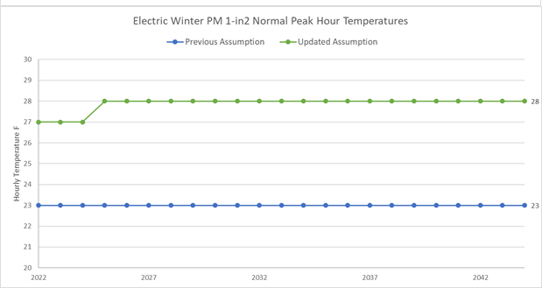
Electric peak hour temperature in winter increases
PSE used the same approach to determine updated normal peak temperatures
For electric normal peak, we used a 30-year centered rolling time period to determine "1-in-2 chance" peak temperatures

Slide 35
Electric peak hour temperature in summer increases

Slide 36
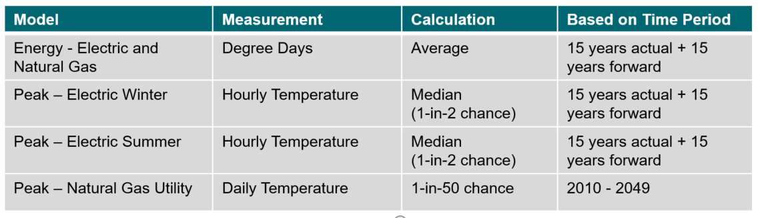
Summary of how climate model data are used in the IRP
Individual years of climate model data were used in the Resource Adequacy model to analyze variability in temperatures and loads.

Slide 37
Climate change in the resource adequacy model
Before:
Used historic weather run through the demand forecast model and peak model to determine a range of possible future hourly demands
Now:
Used 30 years of climate change data from each of the 3 downscaled climate models to determine a range of possible future hourly demands
This data is paired with corresponding hydro data downscaled from the 3 climate models

Slide 38
Climate change hydro data
Pacific Northwest Climate Change Hydroelectric Forecast, Average of All Hydroelectric Facilities
Adapted from the climate change hydroelectric forecast created by the Northwest Power and Conservation Council in the 2021 Power Plan
The hydroelectric forecast represents an average of all three climate change scenarios and an average of the hydroelectric conditions for the 30-year timespan of the climate change scenarios
Calculated hydroelectric capacity based on expected hydroelectric output from the GENESYS regional resource adequacy model using streamflow data representative of the climate change scenarios.

Slide 39
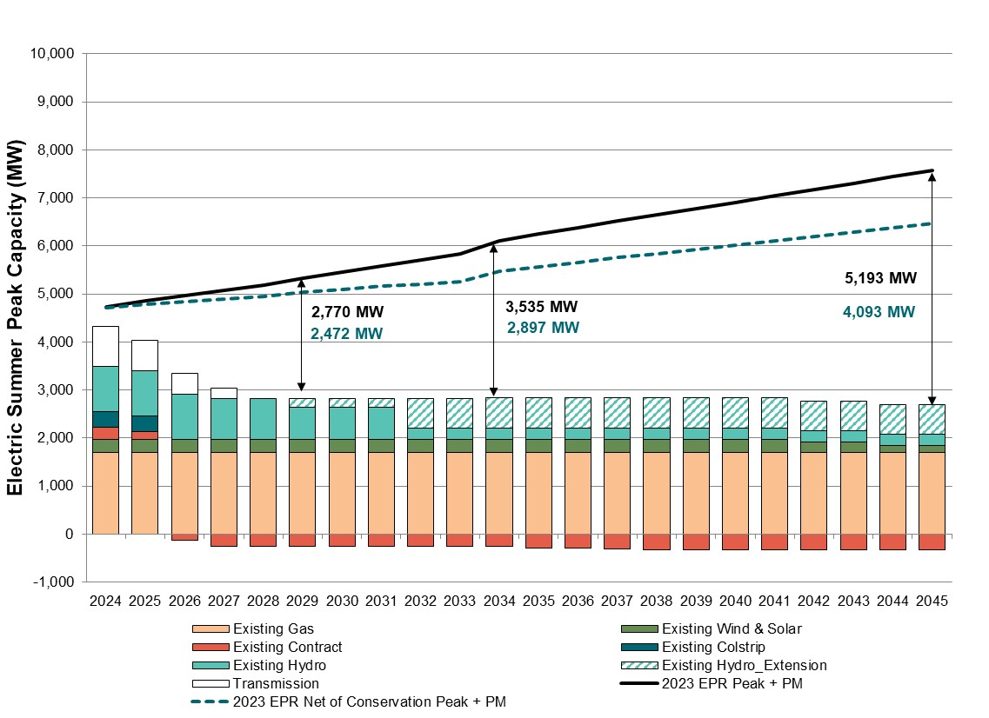
Winter Peak
Summer Peak

Slide 40
Diversified portfolios iterations – nuclear included
Portfolio ID | Description
11 A1 | Combination of the following Portfolios: Portfolio 3: Increase conservation by 284 aMW by 2045 Portfolio 6: Added 400 MW MT East Wind + 200 MW MT PHES in 2026 Portfolio 9: Nuclear added - 250 MW in 2032
11 A2 | Combination of the following Portfolios: Portfolio 3: Increase conservation by 284 aMW by 2045 Portfolio 6: Added 400 MW MT East Wind + 200 MW MT PHES in 2026 Portfolio 8: Added 200 MW PNW PHES in 2026 Portfolio 9: Nuclear added - 250 MW in 2032
11 A3 | Combination of the following: Portfolio 3: Increase conservation by 284 aMW by 2045 Portfolio 4: DER solar added - 30 MW/year from 2026-2045 Portfolio 6: Added 400 MW MT East Wind + 200 MW MT PHES in 2026 Portfolio 8: Added 200 MW PNW PHES in 2026 Portfolio 9: Nuclear added - 250 MW in 2032

Slide 41
Diversified portfolios iterations – nuclear included
Portfolio ID | Description
11 A4 | Combination of the following Portfolios: Portfolio 3: Increase conservation by 284 aMW by 2045 Portfolio 4: DER solar added - 30 MW/year from 2026-2045 Portfolio 5: DER batteries added - 25 MW/year from 2026-2031 Portfolio 6: Added 400 MW MT East Wind + 200 MW MT PHES in 2026 Portfolio 8: Added 200 MW PNW PHES in 2026 Portfolio 9: Nuclear added - 250 MW in 2032
11 A5 | Combination of the following: Portfolio A4 (above) Added all Demand Response programs
11 A5, modified, may not run | Updated A5 with the following: Advanced battery builds: 400 MW of 4hr Li-ion built in 2024/2025 instead of in 2025/2026 Delayed 1 biodiesel peaker build from 2024 to 2026

Slide 42
Diversified portfolios iterations – no nuclear
Portfolio ID | Description
11 B1 | Combination of the following Portfolios (similar to 11 A1): Portfolio 3: Increase conservation by 284 aMW by 2045 Portfolio 6: Added 400 MW MT East Wind + 200 MW MT PHES in 2026
11 B2 | Combination of the following Portfolios (similar to 11 A5): Portfolio 3: Increase conservation by 284 aMW by 2045 Portfolio 4: DER solar added - 30 MW/year from 2026-2045 Portfolio 5: DER batteries added - 25 MW/year from 2026-2031 Portfolio 6: Added 400 MW MT East Wind + 200 MW MT PHES in 2026 Portfolio 8: Added 200 MW PNW PHES in 2026 Add All DR Programs

Slide 43
Portfolio CBI Metrics
CBI Metric | 1 Reference | 11 A5 Portfolio | 11 B2 Preferred Portfolio
22-year Cost with SCGHG ($, Billions) | 20.85 | 23.67 | 22.51
GHG Emissions (Short Tons) | 48,824,734 | 41,543,008 | 44,372,601
SO₂ Emissions (Short Tons) | 28,841 | 28,836 | 28,759
NO_{x} Emissions (Short Tons) | 11,426 | 10,307 | 10,805
PM Emissions (Short Tons) | 9,036 | 8,873 | 8,940
Jobs (Total) | 45,736 | 40,757 | 43,795
Energy Efficiency Added (MW) | 695 | 818 | 818
DR Peak Capacity (MW) | 291 | 320 | 320
DER Solar Participation (Total New Participants) | 12,115 | 83,903 | 87,492
DR Participation (Total New Participants) | 513,238 | 750,943 | 750,943
DER Storage Participation (Total New Participants) | 8,125 | 18,524 | 18,524

Slide 44
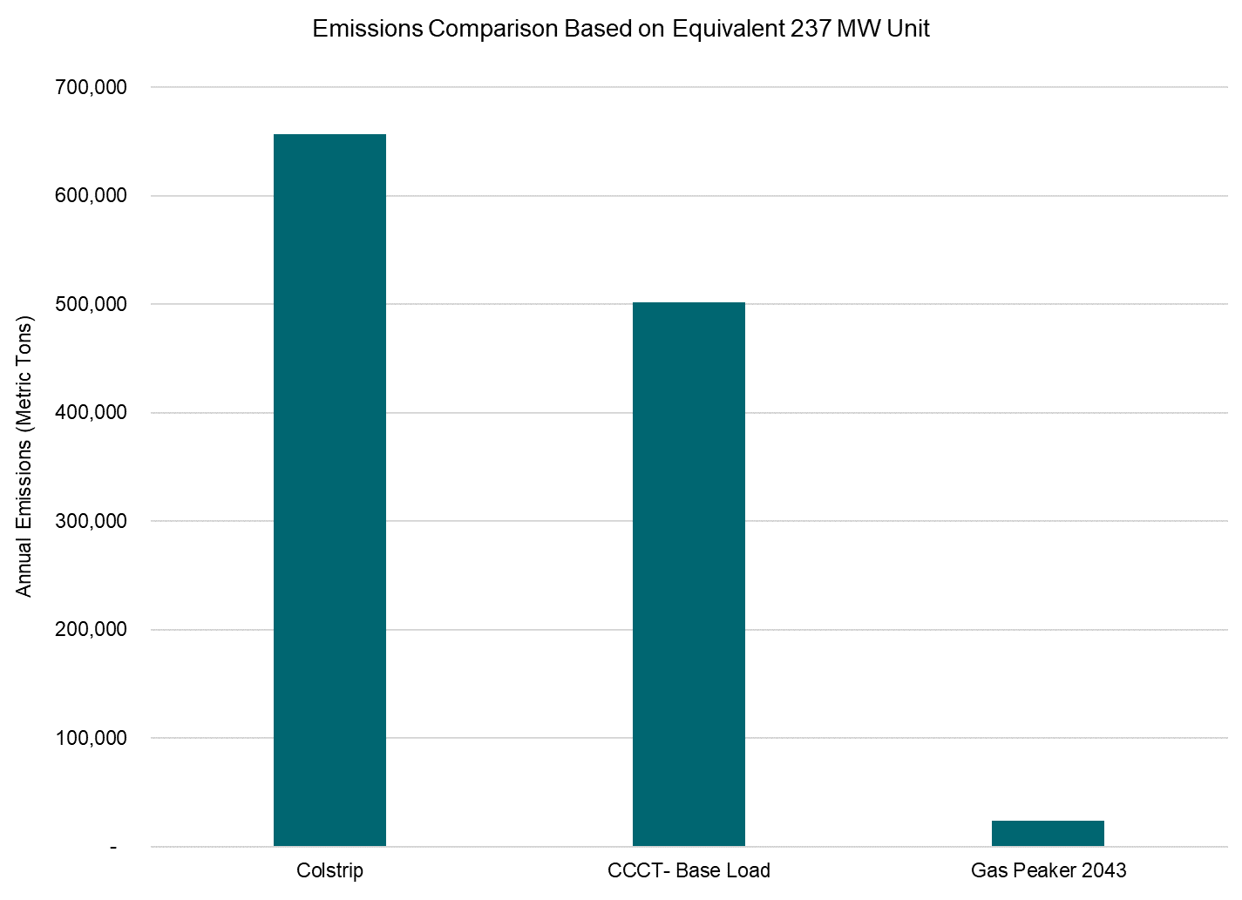
Hydrogen fuel risk
Preferred Portfolio:
New blend hydrogen peakers start in 2039
Participant Concern:
What if PSE built peakers that will blend to full hydrogen but hydrogen is not available as planned?
Response:
PSE would not start building a hydrogen peaker in 2035 if hydrogen supply is unavailable
Benefits of a dual-fuel unit: biodiesel provides back-up (reliability), the unit could run on biodiesel if hydrogen unavailable
Further Analysis:
Comparison of the emissions profile of a gas peaker in 2043, if it had to run on gas only, as compared to Colstrip and a CCCT of equal capacity.

