Slide 1

2023 Gas Utility IRP
Phillip Popoff, Director Resource Planning and Analysis, PSE
Allison Jacobs, Senior Economic Forecasting Analyst, PSE
June 26, 2023

Slide 2
PSE 2023 Gas Utility IRP
Summary of Preferred Resource Plan
Overview of public participation process
Equity considerations
Scenarios and Portfolios Examined
Climate Change
Action Plan

Slide 3
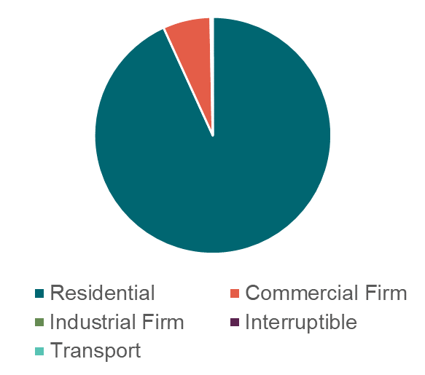
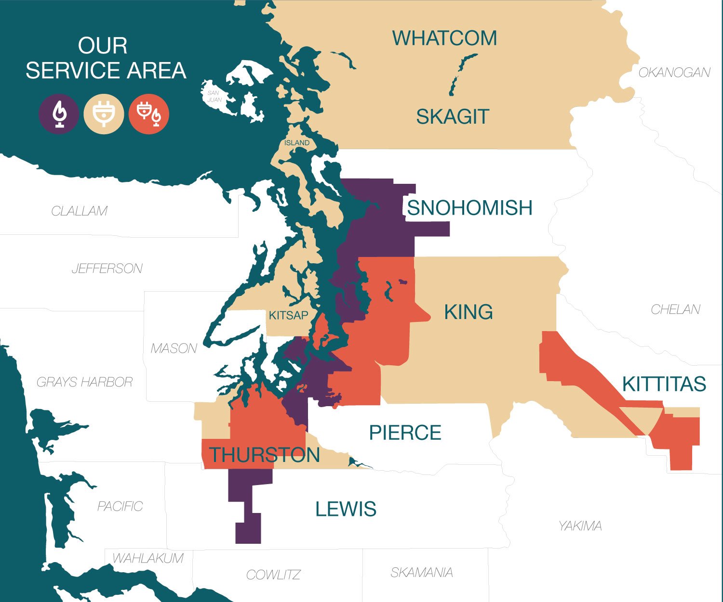
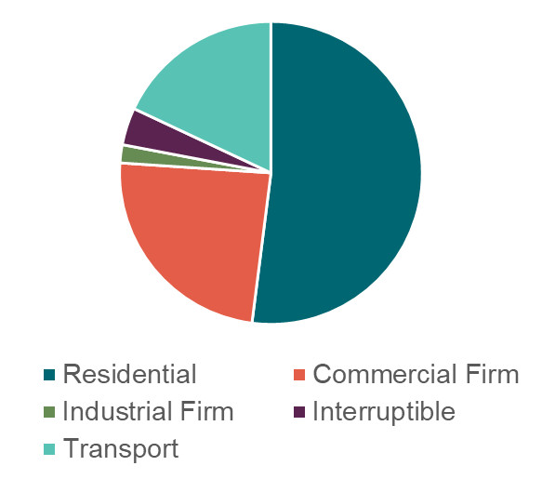
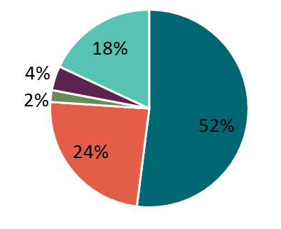
PSE's gas utility service area and customers
2022 Gas Customers
Total: 800,000
2022 Gas Sales

Slide 4
New challenges and opportunities
Climate Commitment Act (CCA)
Climate Change Modeling
Electrification Analysis
Inflation Reduction Act
Diversity in Supply and Alternative Fuels

Slide 5
2023 gas preferred portfolio: the resource plan
This resource mix of PSE-owned resources helps maintain a flexible gas portfolio while ensuring enough resources to meet customer needs regardless of changes in customer demand.
Key Findings:
  Portfolio has flexibility to adapt to changing market/policy conditions
  Declining demand over time from a combination no growth in customers and increased conservation
  Lower cost new peaking resources replacing firm pipeline contracts
  Renewable fuels that are delivered on the PSE system do not require pipeline capacity
Resource (Mdth/d) | 2030 | 2040
Conservation | 61 | 127
Swarr Propane Plan | 30 | 30
Plymouth LNG | 15 | 15
Pipeline Renewals | (142) | (195)
RNG PNW Region | - | -
RNG on-system | 1 | 2
Green H2 – Gas Blending | 9 | 14
Net Resources | (87) | (134)

Slide 6
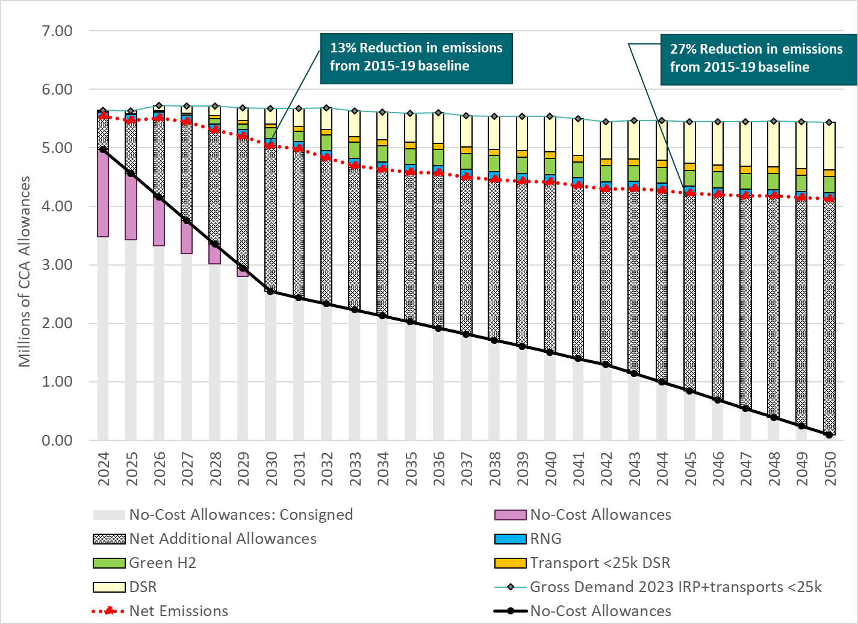
2023 gas preferred portfolio – CCA allowances

Slide 7
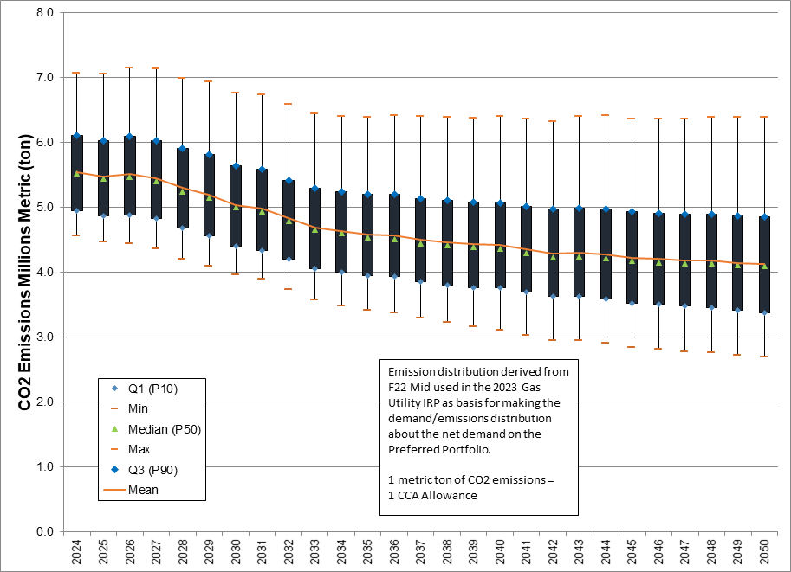
Weather has significant impact on need for CCA allowances

Slide 8

Public participation snapshot
Access through online webinars and recordings
14
64
135
251
IRP webinars recorded and posted online
Average number of webinar participants
Organizations participated in webinars
Unique individuals participated in webinars
Online interested party feedback
E-newsletter communication
45
10
29
1,210
Feedback forms received and responded to
Email communications distributed
Feedback reports prepared
Interested parties opting to receive IRP newsletter
irp@pse.com
pse.com/irp

Slide 9
How public feedback shaped our work
  Incorporated climate change data
  Considered alternative fuels
  Incorporated Inflation Reduction Act on supply-side resources*
  Conducted electrification analysis
  Examined State Energy Strategy (SES)
  Examined zero growth scenarios; chose zero growth demand in preferred portfolio
*Multiple public participation participants urged PSE to incorporate demand-side resource impacts as well. These federal programs are still taking shape and PSE does not have enough information to model these impacts. Therefore, in this IRP, we were not able to analyze how those layers of subsidies might affect customer decisions with regard to retaining or replacing gas appliances.

Slide 10

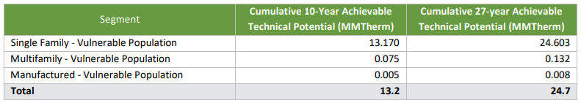
Equity considerations – conservation potential
Segmentation of residential customers based on vulnerable populations
Residential – Single family, multifamily, and manufactured
Used PSE 2021 Residential Characterization Survey to inform segmentation
Used low-income weatherization program measures to map onto vulnerable population

Slide 11
Purpose of scenario analysis in integrated resource plan
Focus on how different external market/policy conditions will affect the resource plan, specifically impacts on:
Cost-effective conservation
Renewable fuels
New peaking resources
Pipeline contract renewals
Resource characteristics included:
Energy
Capacity
Greenhouse Gas Emissions-social cost of greenhouse gas for direct and upstream emissions
CCA allowance impacts

Slide 12
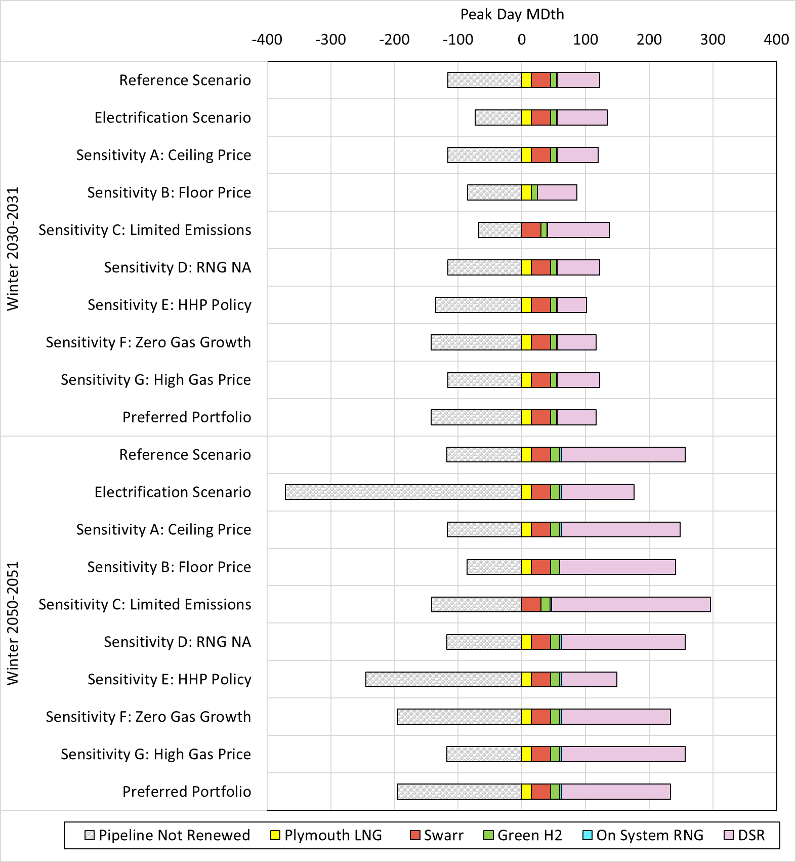
Pipeline capacity renewals primary difference across scenarios
Scenarios are market and policy conditions, not PSE choice variables
Portfolios are resource decisions PSE can make

Slide 13
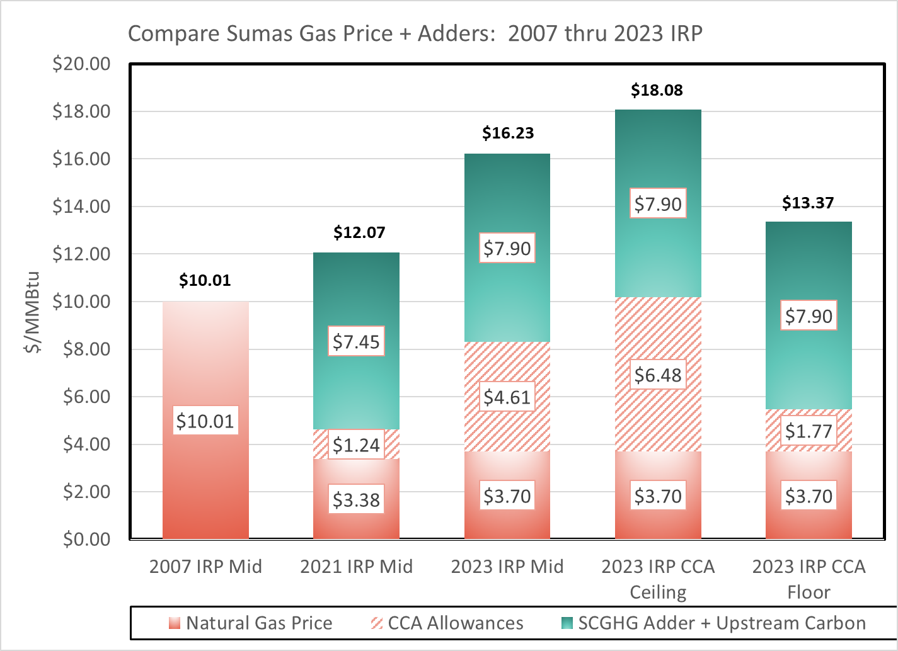
At CCA ceiling price, direct gas cost similar to 2007 forecast

Slide 14
Electrification scenarios in 2023 Gas IRP included Electric Portfolio impacts by leveraging the 2023 Electric Progress Report model
Two base technologies in electrification rest in energy efficiency supply curve:
  Air Source electric heat pumps in electrification with high efficiency heat pumps included in the energy efficiency supply curve (consistent with the Council’s 2021 Plan)
  Air source hybrid heat pumps with gas peaking back up
Tested market and policy approaches:
  Market approach to hybrid heat pumps only in residential space heating
  Policy includes all customer classes and all end uses - some limits to commercial and industrial loads: 70% in commercial and 30% in industrial application can convert
Looked at impacts of energy, capacity and costs on the gas and electric systems

Slide 15
Electrification analysis modeling approach
Cadmus
Conducted a customer survey that developed the adoption curve for various end use heating technologies
Load & Conservation bundles created for each scenario
Gas Model
Ran each scenario with different gas load impacts through SENDOUT model
Electric Model
Ran each scenario with different electric load impacts through Aurora model
Results
Evaluated the results looking at impacts to both the gas & electric portfolio
Looked at emission reduction and costs for each
Note – this analysis only looks at portfolio impacts
Note: used the 23 Electric Progress Report least cost portfolio as base

Slide 16
Assumptions about future temperatures are changing
Standard practice
New practice
Backward- looking
Incorporate climate model temperature data
Forward-looking
This is a summary of the information presented to interested parties at the January 20th, 2022 meeting.

Slide 17
Summary of how climate model data are used in the IRP
Model | Measurement | Calculation | Based on Time Period
Energy - Electric and Natural Gas | Degree Days | Average | 15 years actual + 15 years forward
Peak – Natural Gas Utility | Daily Temperature | 1-in-50 chance | 2010 - 2049
Peak – Electric Winter | Hourly Temperature | Median (1-in-2 chance) | 15 years actual + 15 years forward
Peak – Electric Summer | Hourly Temperature | Median (1-in-2 chance) | 15 years actual + 15 years forward

Slide 18
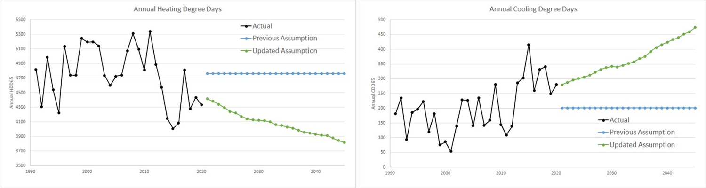
For energy modeling, we used a 30-year normal HDD, centered on the year of interest, rolling forward over time

Slide 19
For energy modeling, we used a 30-year normal CDD, centered on the year of interest, rolling forward over time

Slide 20
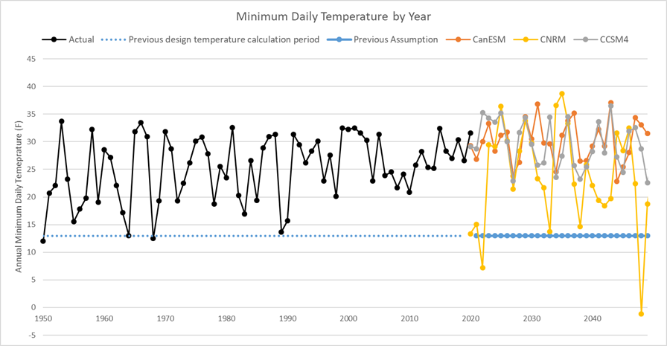
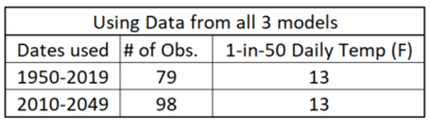
Determining a new design peak day temperature assumption for natural gas utility peak model
The design temperature for natural gas utility peak is based on extreme temperatures
Now: "1-in-50 chance" annual coldest daily temperatures occurring between 2010-2049: Still 13 F/day

Slide 21
The action plan
Intermediate Term
(2024 – 2029)​
Long Term
(2030 – 2045)
Explore clean technology and fuels such as direct air capture, green hydrogen, and RNG
Continue to acquire cost-effective conservation
Explore which expiring pipeline contracts would be feasible to let expire rather than renew
Determine technical feasibility and any other issues of upgrading the Swarr propane-air injection facility
Purchase CCA allowances to meet CCA compliance requirements
Reduce emission profile by exploring Renewable Natural Gas (RNG) within the Pacific Northwest and outside the region
Continue to assess non pipe alternatives on the gas distribution system
Turn back transport pipeline capacity to the pipeline company when the portfolio becomes surplus due to decreasing loads
Continue to assess electrification as a decarbonization option for the gas utility
Participate in green hydrogen activities in the PNW
Continue engagement to develop and deliver on a plan to meaningfully incorporate equity considerations into the 2025 IRP

Slide 22
Thank you for attending

Slide 23
Appendix

Slide 24
PSE electrification study service area assumptions
PSE Service Area Impacts:
Electric only – natural gas equipment converts to electric (increases PSE electric load)
Natural gas only – converted to electric equipment (reduces PSE natural gas load)
Combination service – converted to electric equipment (increases PSE electric load and reduces PSE natural gas load)

Slide 25

This is the first step for incorporating climate change into planning
Content presented today is PSE’s first step in reflecting climate change in the demand forecast and resource plan
We expect the methodologies and data available will continue to evolve over time
There are no industry standards or best practices for climate change assumptions. PSE is part of the EPRI Climate READi project which is focused on creating industry standards for using climate change data in utility planning processes.
This is a summary of the information presented to PSE’s stakeholder at the January 20th, 2022 meeting.

Slide 26
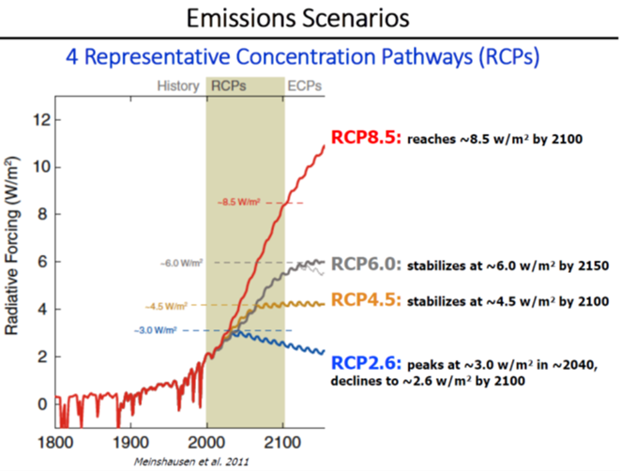
Climate change models for the region have been developed and used by the Northwest Power and Conservation Council
•A coalition including climate scientists, Bonneville Power Administration, US Army Corps of Engineers, and Bureau of Reclamation created climate models for the region
www.nwcouncil.org/2021powerplan_summary-climate-change-scenarios
•The Northwest Power and Conservation Council’s draft 8th Power Plan was issued in September 2021
www.nwcouncil.org/2021-northwest-power-plan
•The Council uses temperature projections downscaled for the region from three different Global Circulation Models

Slide 27
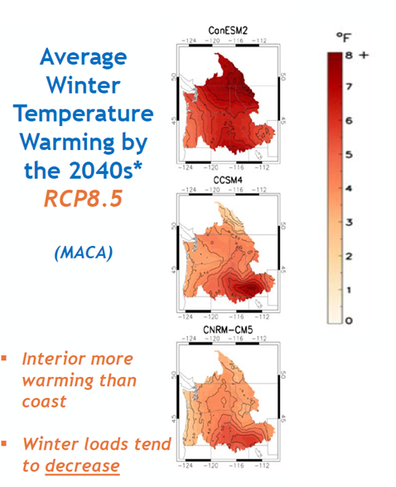
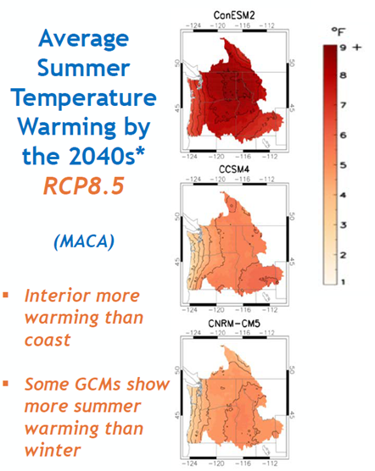
Climate change models selected by the Council for use in 8th power plan
CanESM2
•Warm in winter
•Hot in summer
CCSM4
•High hydro in winter
•Low hydro in summer
CNRM
•Less overall warming in winter and summer
•Low hydro in winter
•High hydro in summer

Slide 28
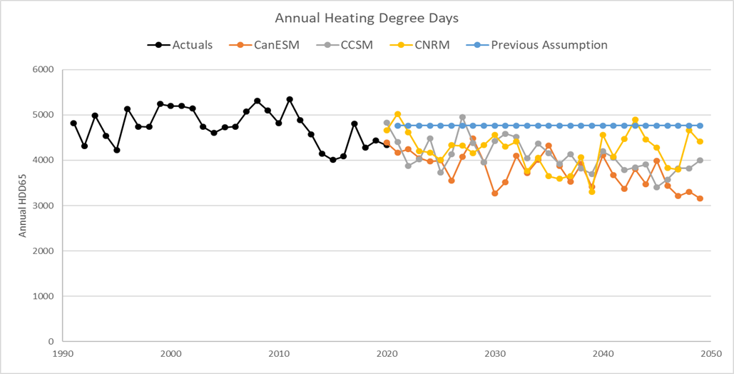
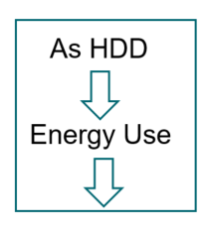
To explore the data, we calculated heating degree days from the climate model temperatures

Slide 29
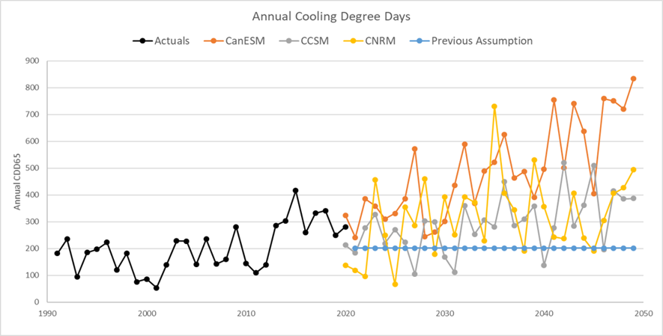
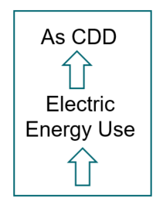
We calculated cooling degree days from the climate model temperatures

Slide 30
Electrification drives need for allowances down

Slide 31
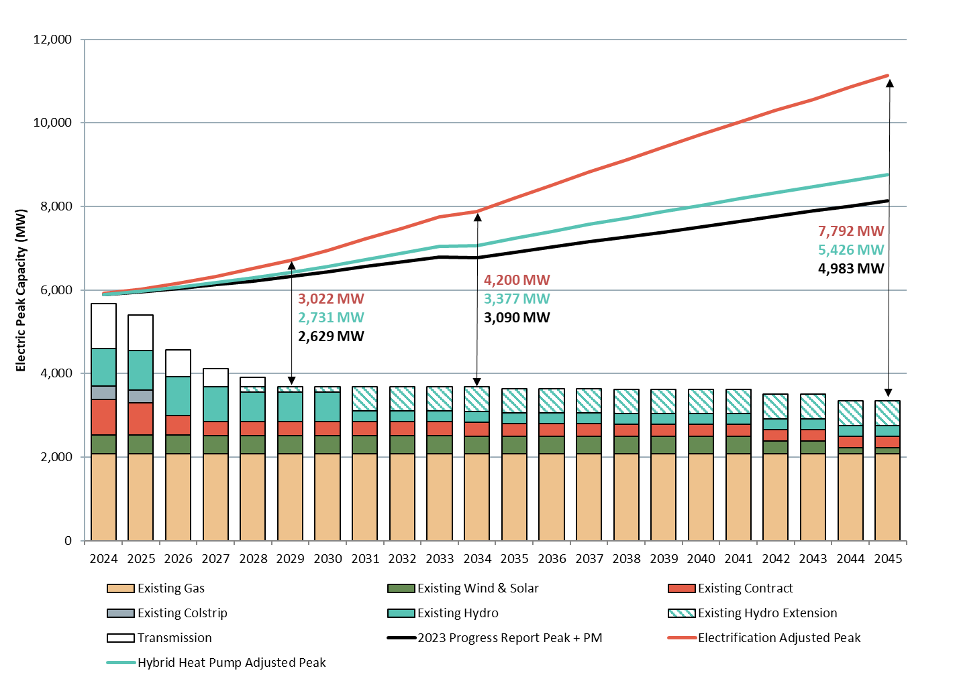
Electrification increases electric peaks by 3,000 MWs, HHP scenario increases electric peaks by 500 MWs
  Electrification scenario increases electric peak capacity deficit by almost 3,000 MW for a total of 7,800 of new capacity needed by 2045
  Hybrid Heat Pump (HPP) scenario increases peak capacity deficit by 500 MW for a total of 5,400 MW of new capacity needed by 2045.

Slide 32
Electrification increases builds by 2,000 MWs, HHP scenario increases builds by 600 MWs
Nameplate Resource Additions (MW)
  The full electrification scenario builds almost 2,000 MW more CETA-qualifying peaking capacity by 2045, while the HHP scenario results in nearly 600 MW more than the reference portfolio.
  Both the electrification scenario and the HPP scenario has an increase in the demand forecast of around 7 MWh from the reference by 2045. This is met with an increase in
    Conservation
    Wind & solar

